Slide 1
Programme
- Northumbria HG & PGClub -
4th September 2013
Ed Cleasby
- PROGRAMME -
Introduction
Defined Flying Challenges in the Lakes, Dales and Pennines
A personal insight into flying the Lake District (FH)
A personal insight into flying the Yorkshire Dales (GOC)
Questions are welcome at any point
www.xcflight.com
Supporting Newcastle Utd since August

Slide 2
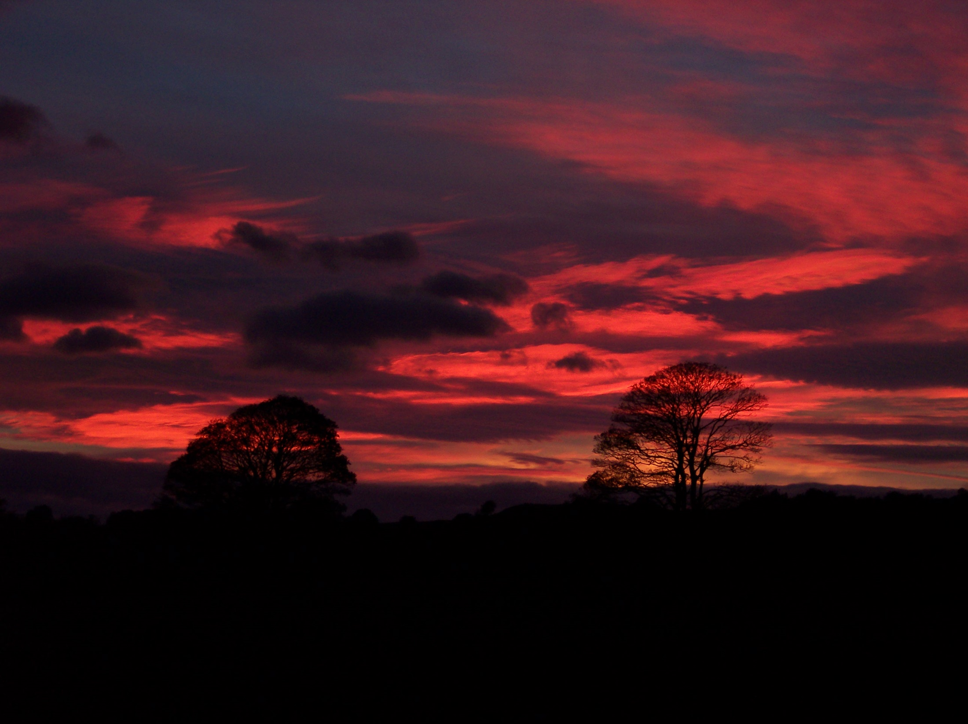
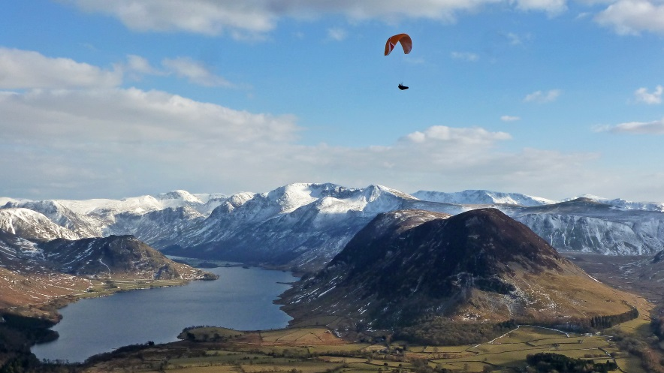
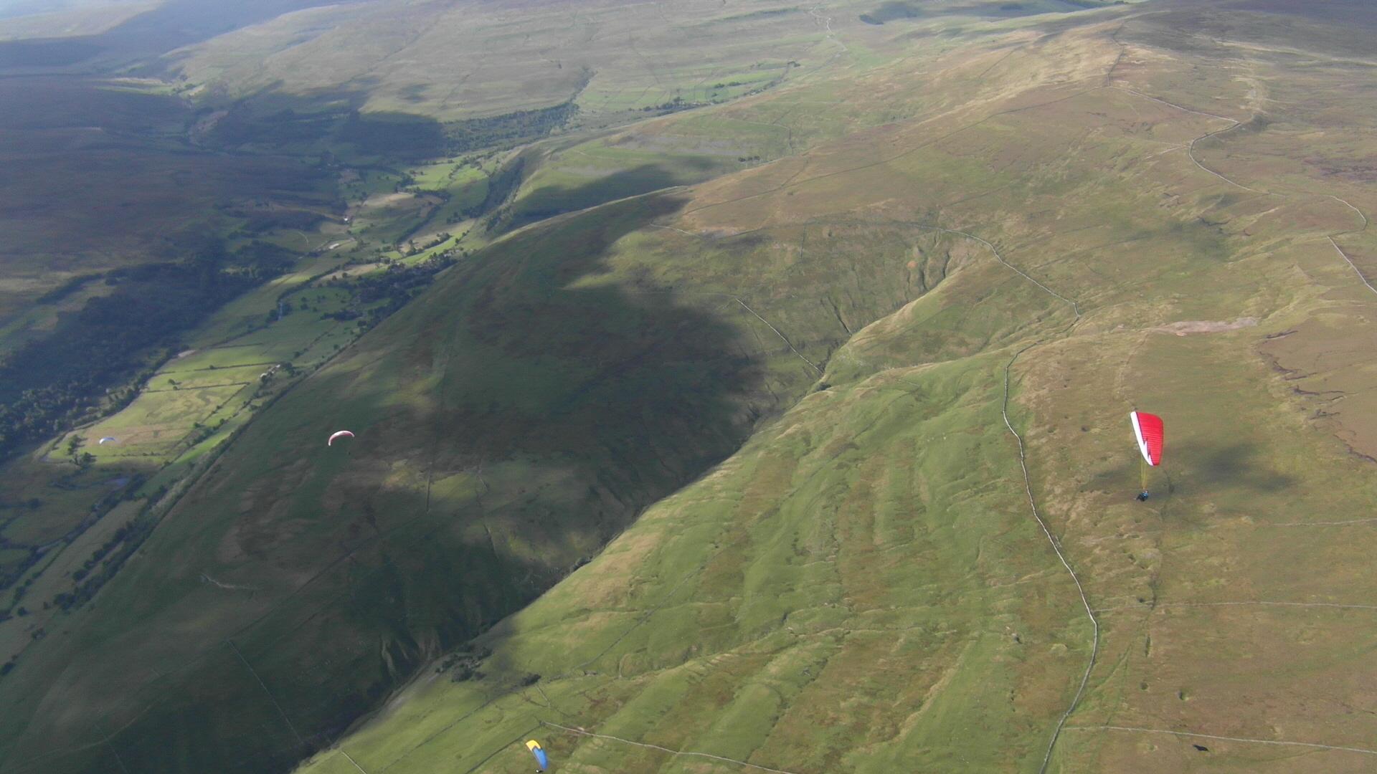
Flying Heaven v God’s Own Country
(Yet another comparison site)
Topography - physical character of the area
Meteorology - weather influences and patterns
Flying the area - lesser known places/sites/routes
A personal insight into flying the Lake District and the Yorkshire Dales

Slide 3
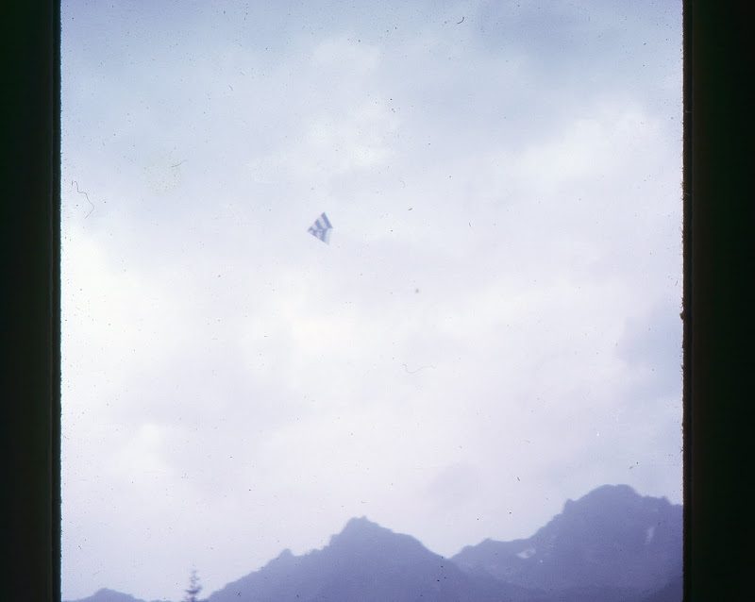
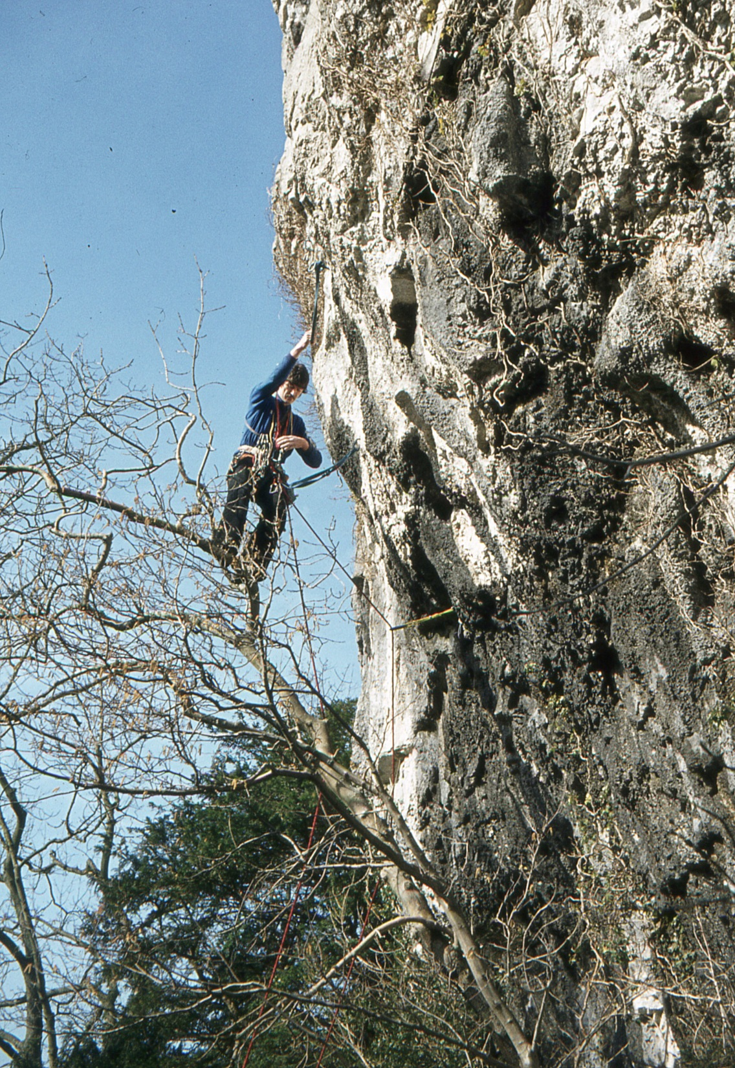
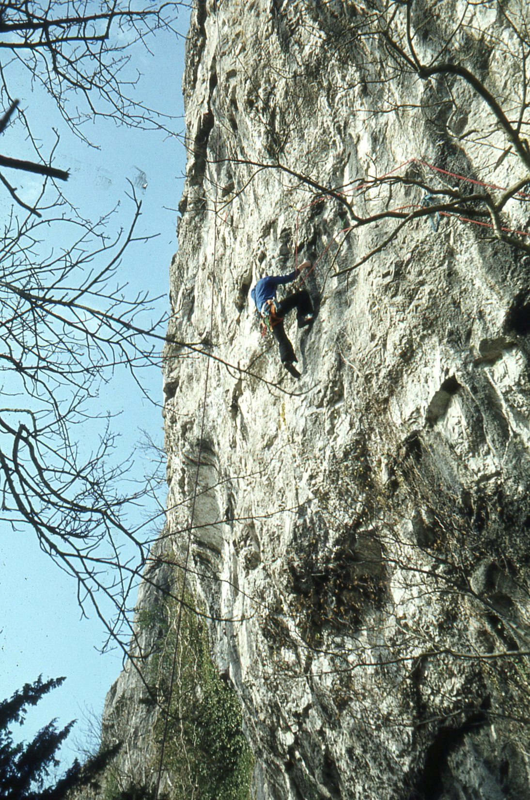
Introduction – background ‘72 – ’91 (Climbing)
Chamonix – summer ‘73

Slide 4
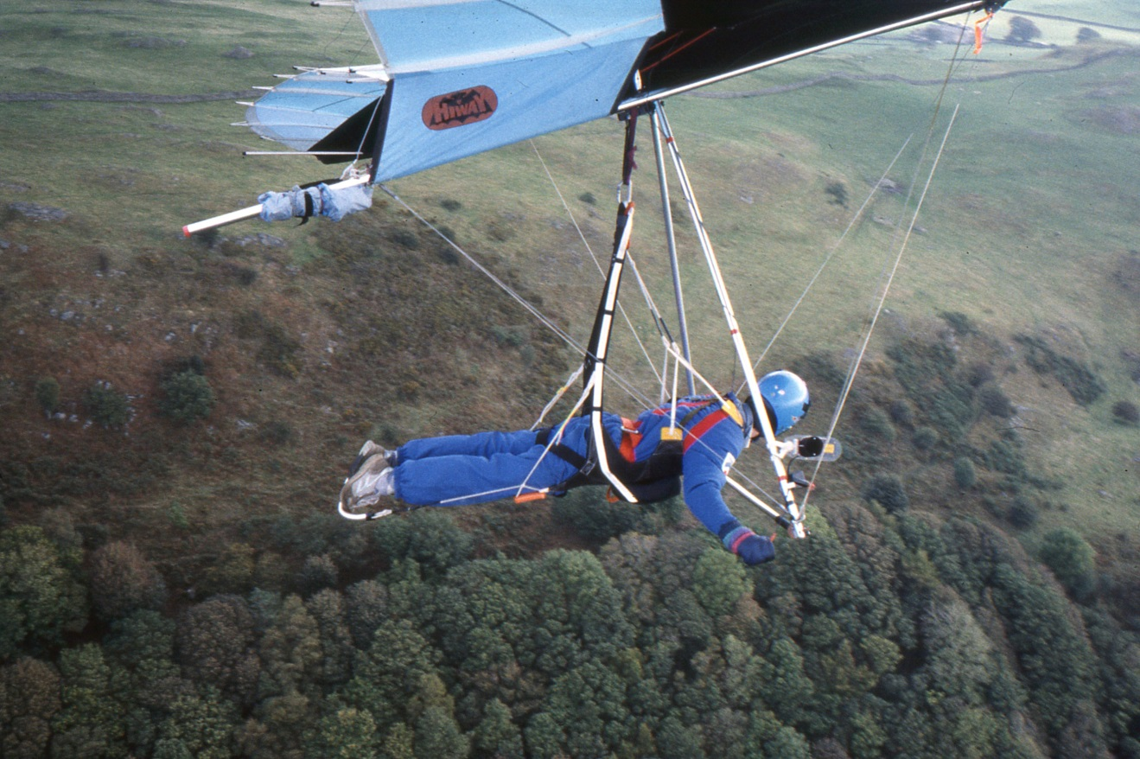
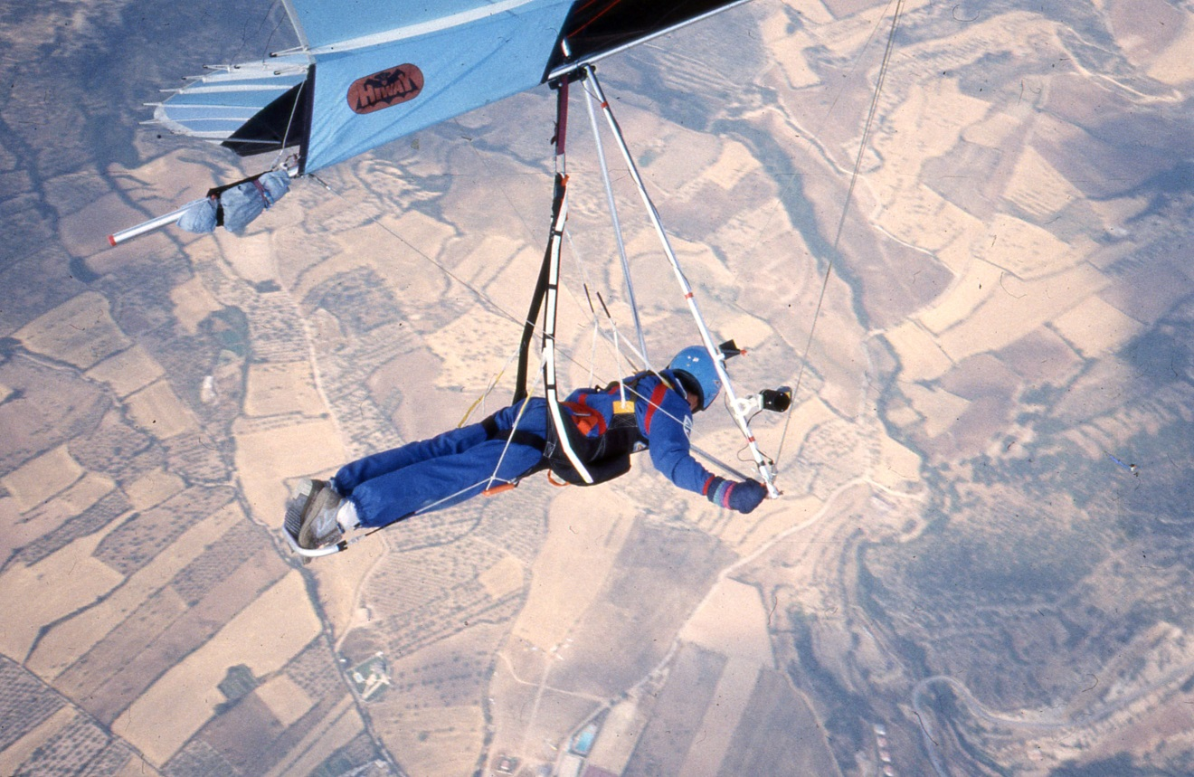
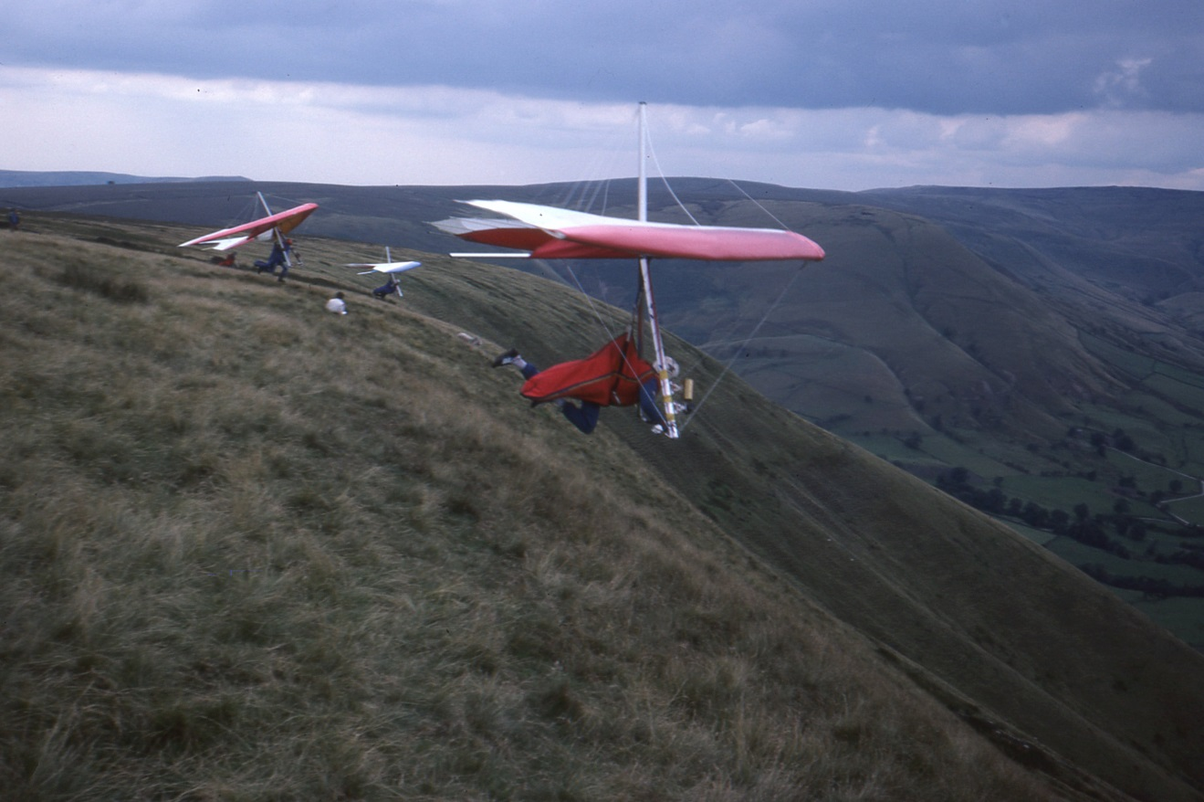
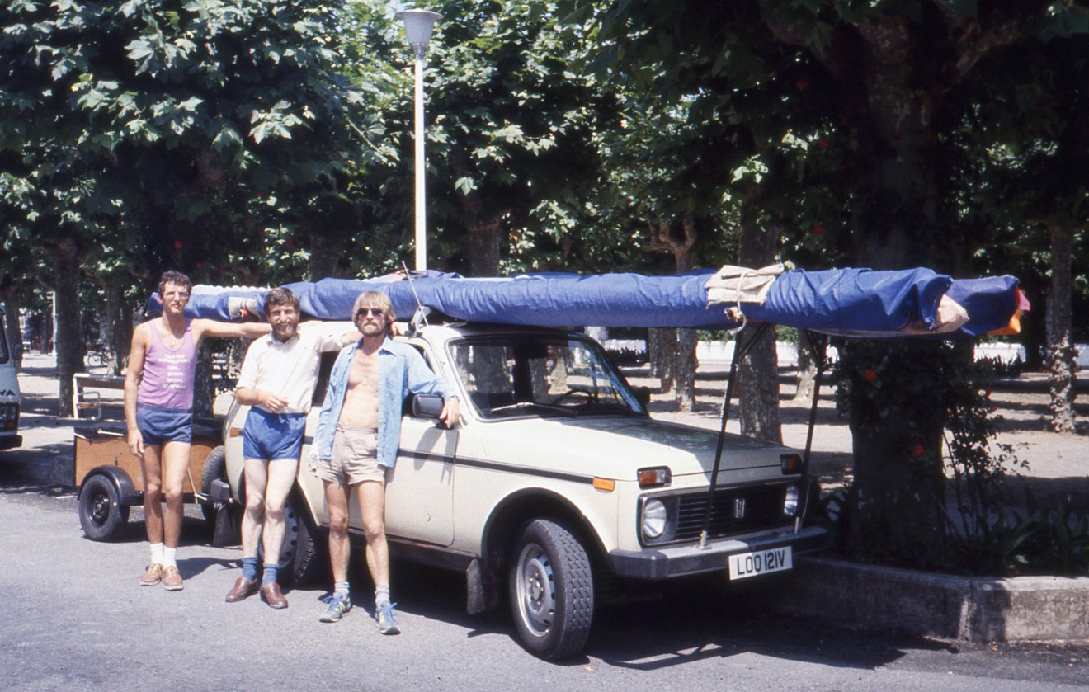
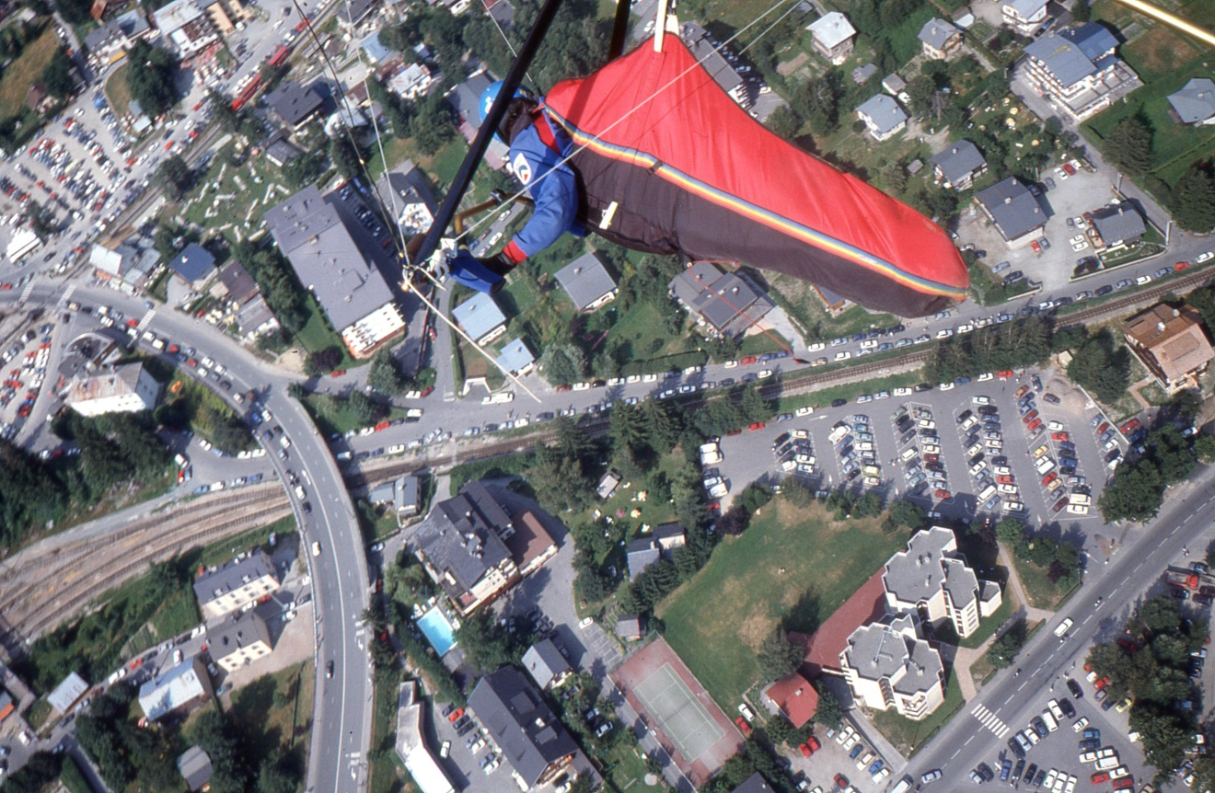
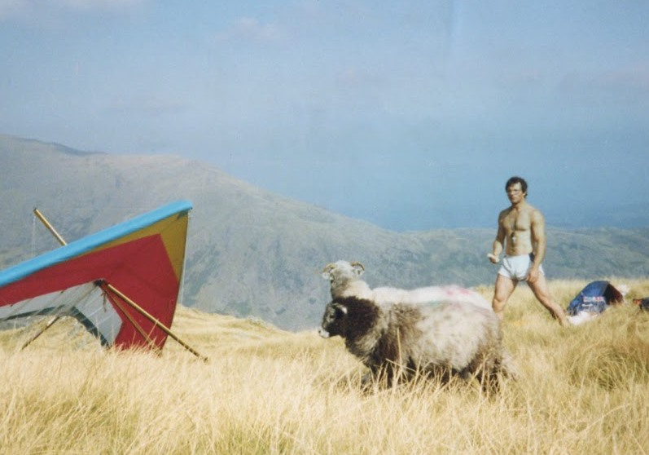
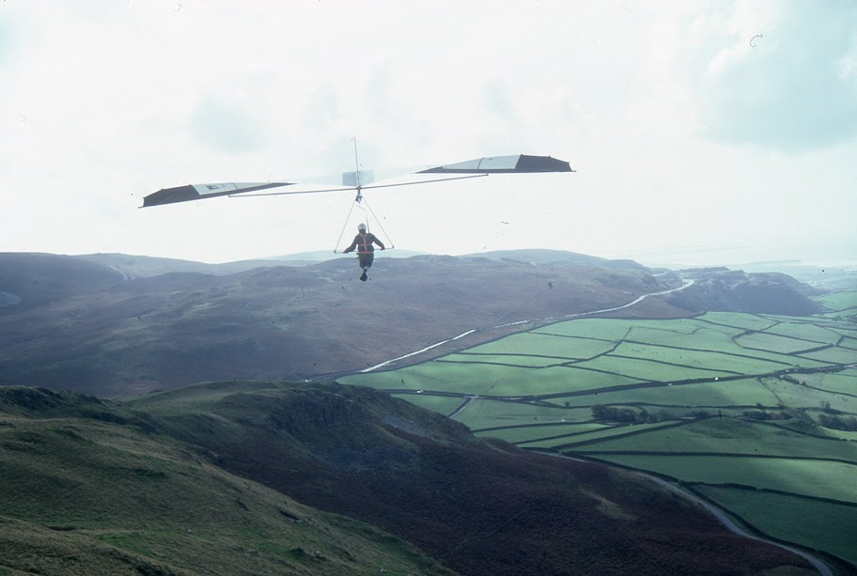
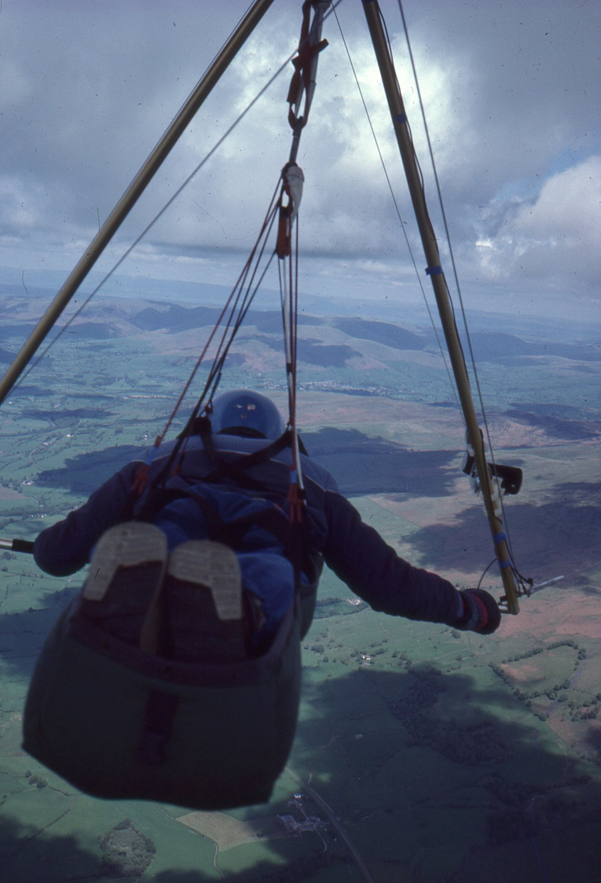
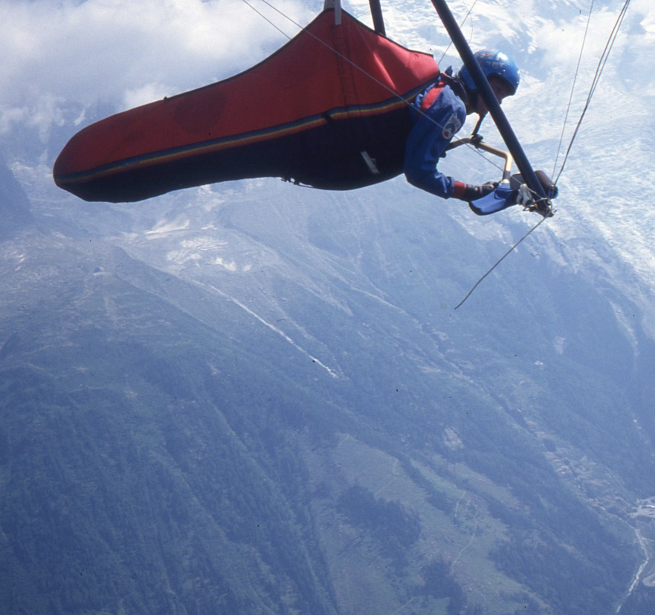
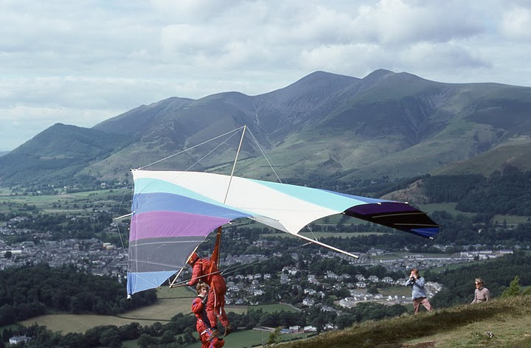
Introduction – background ‘79 – ’97 (hang gliding)

Slide 5
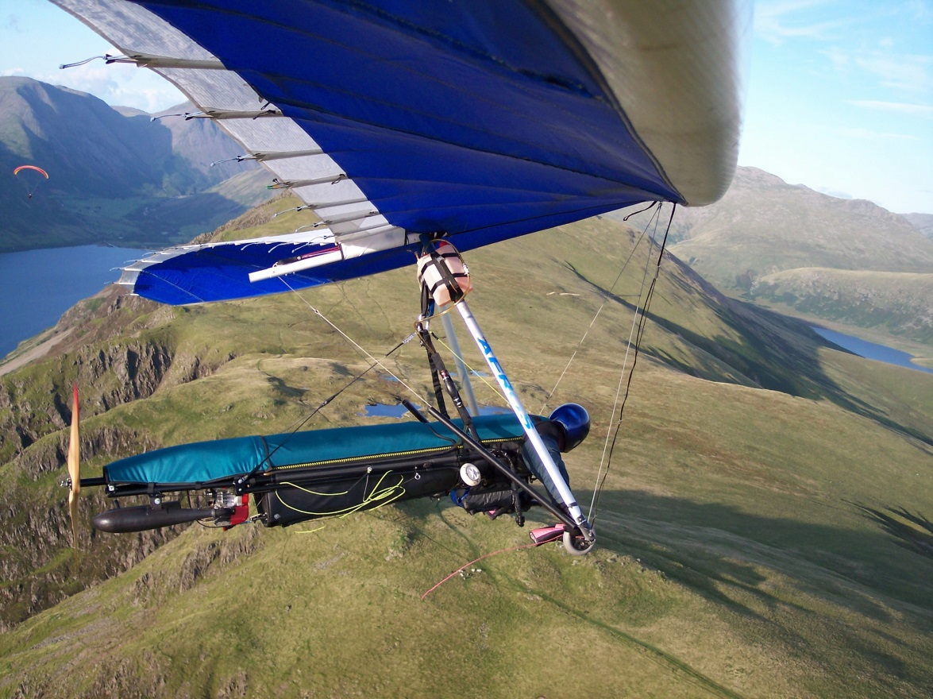
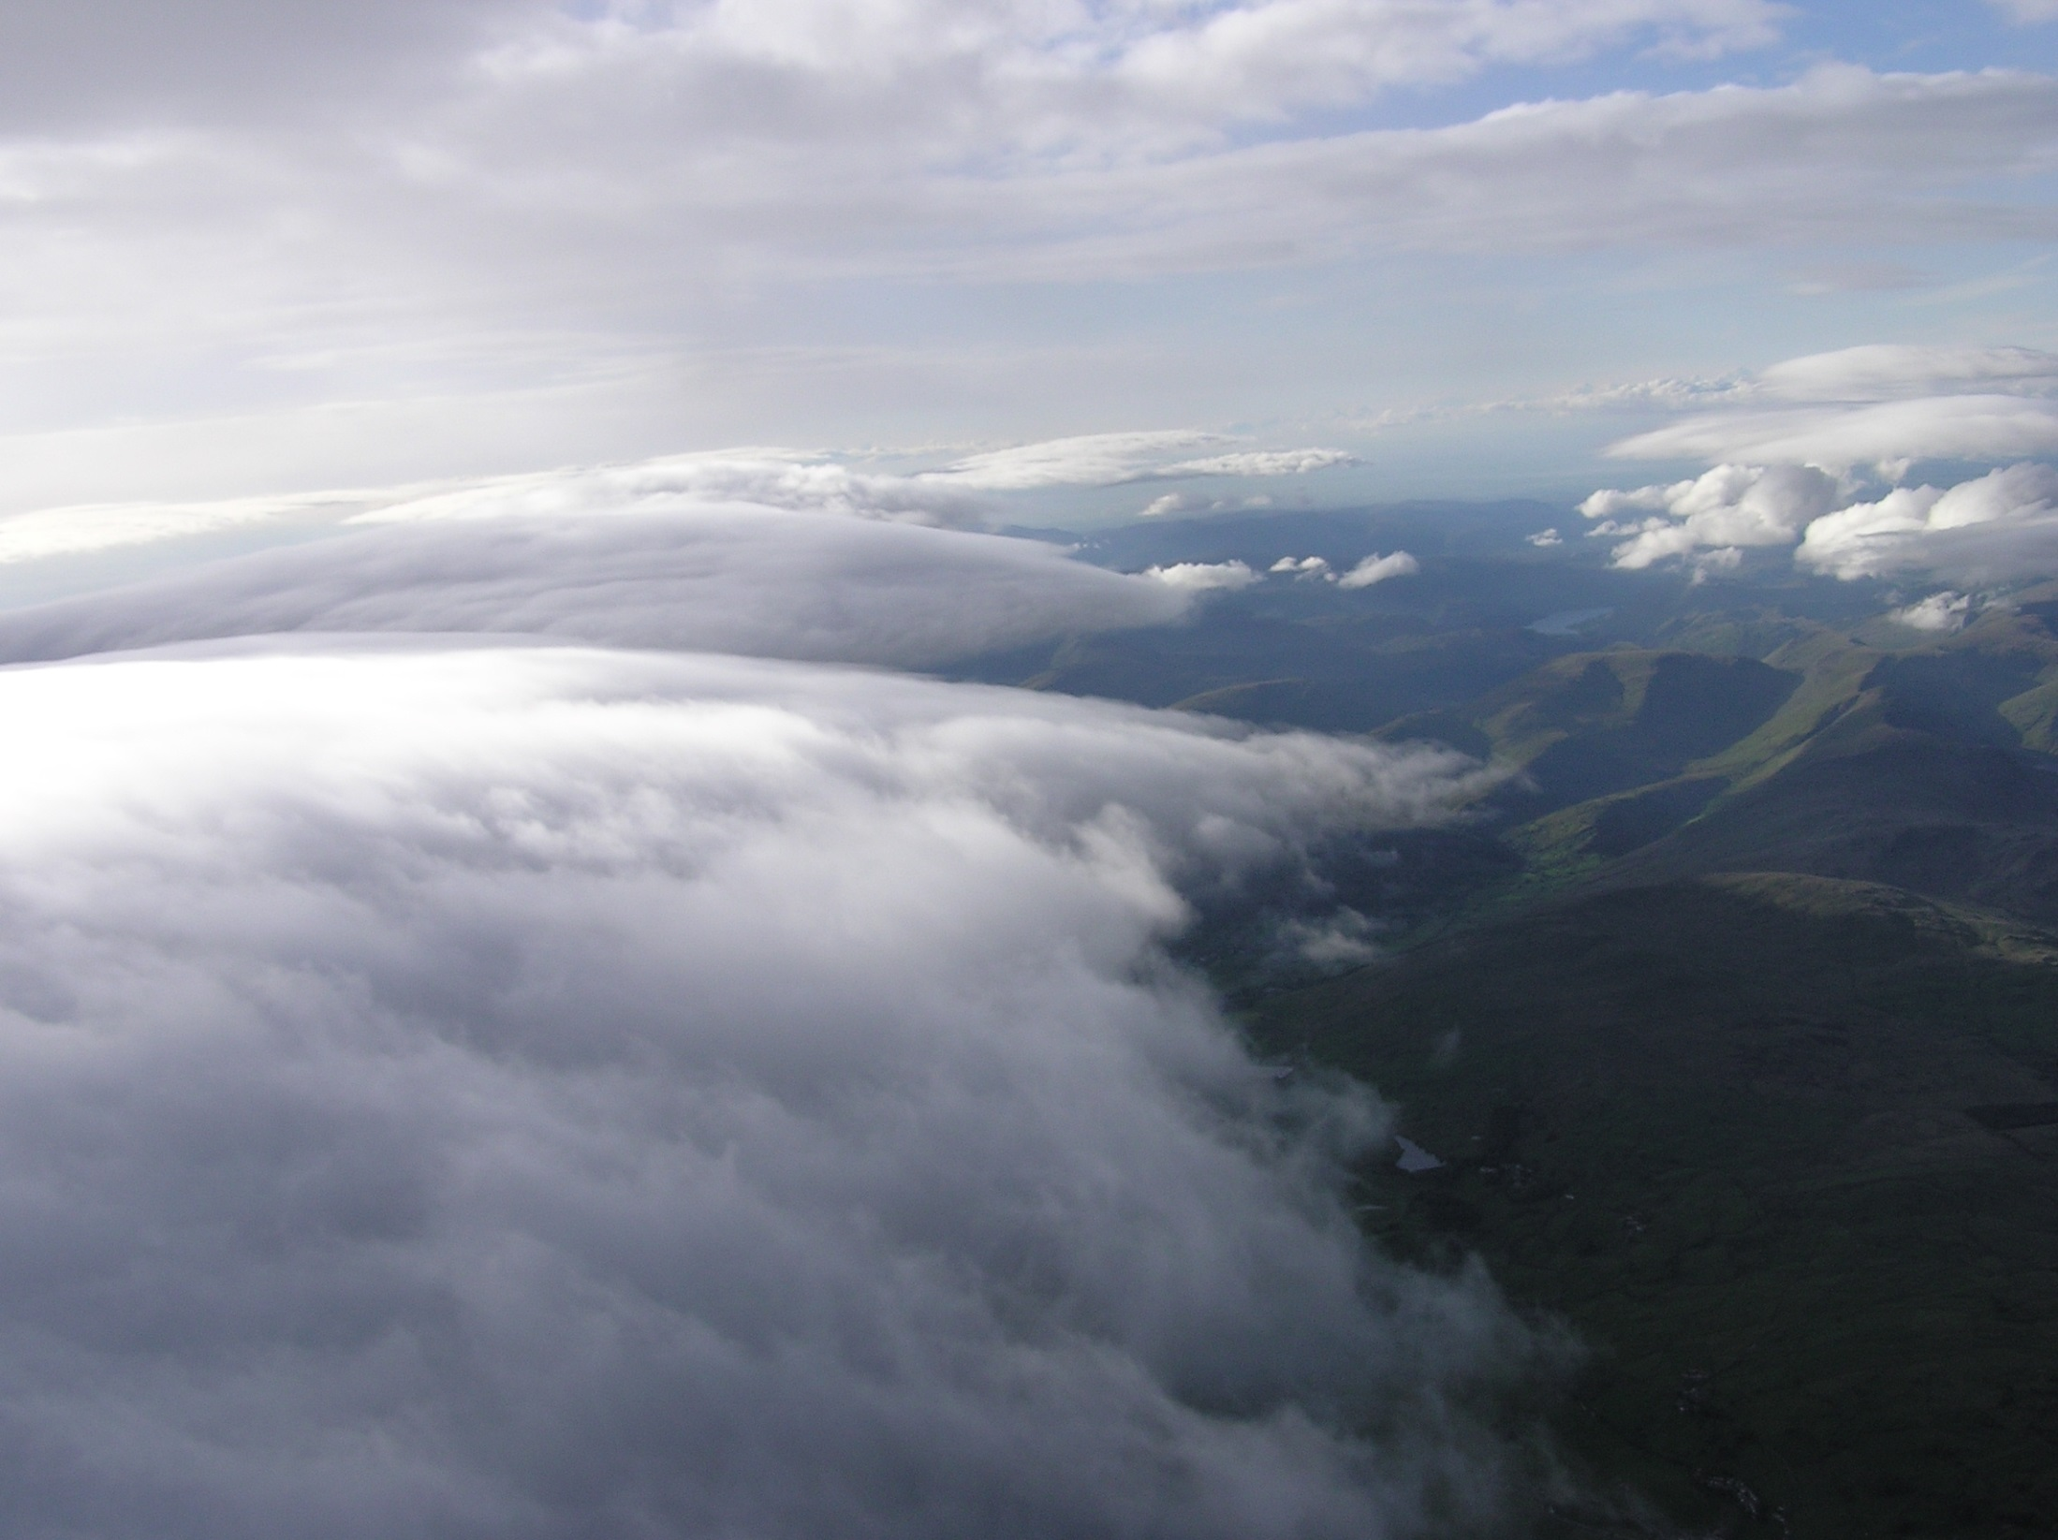
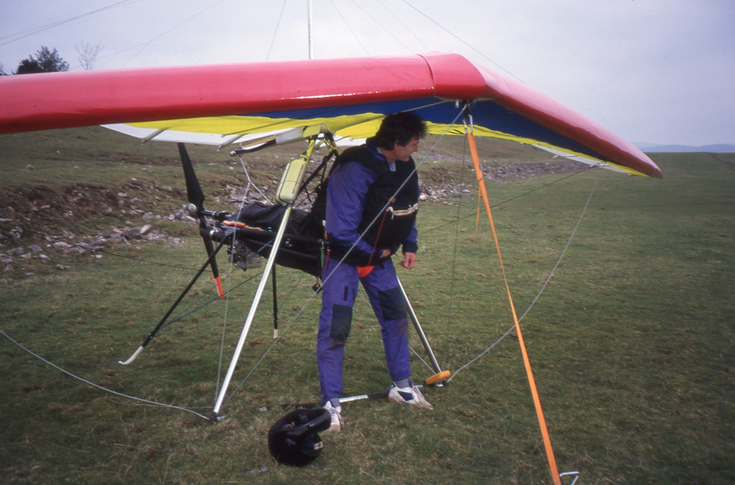
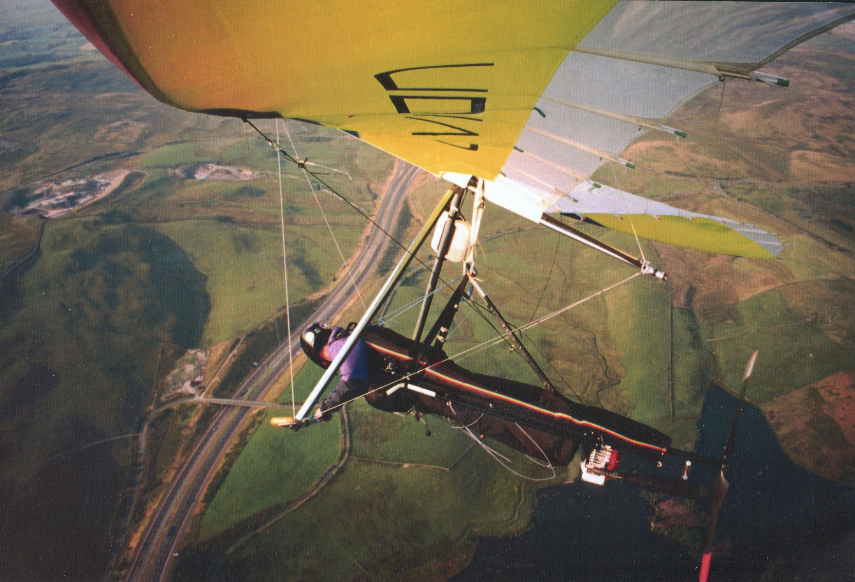
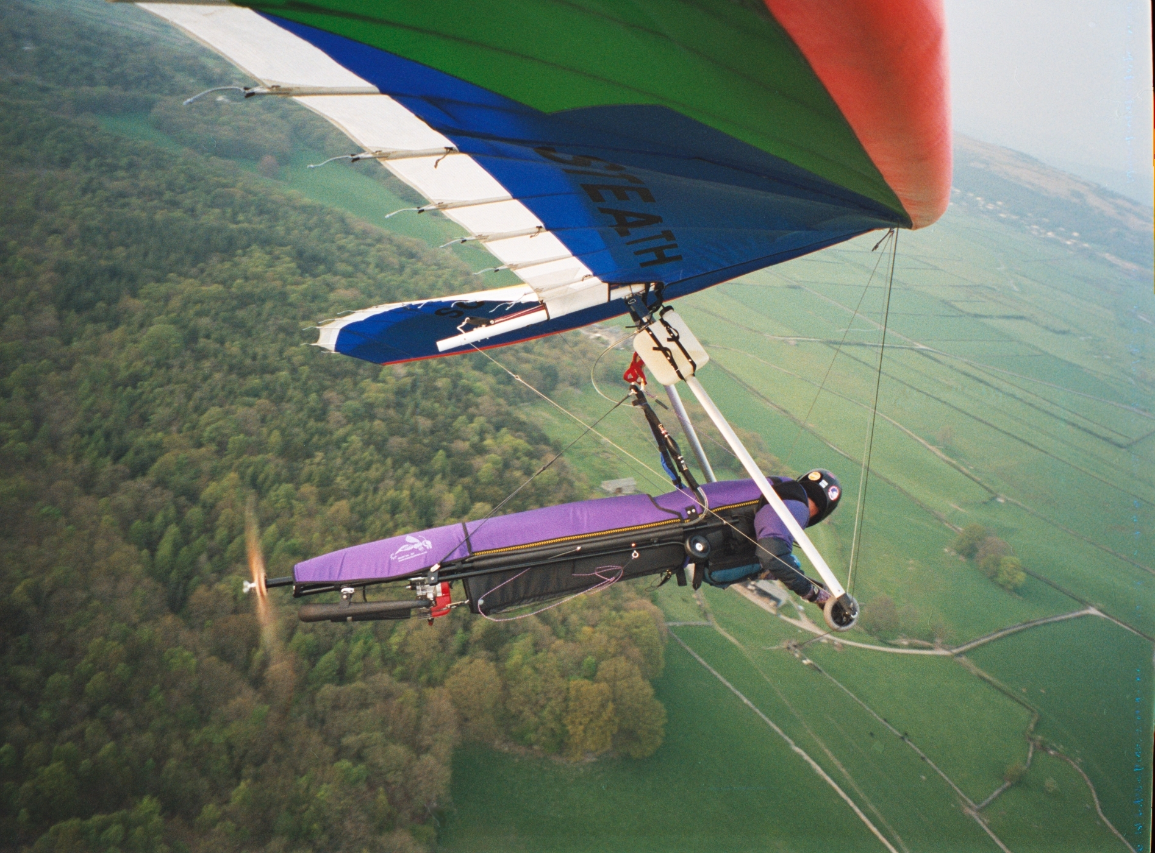
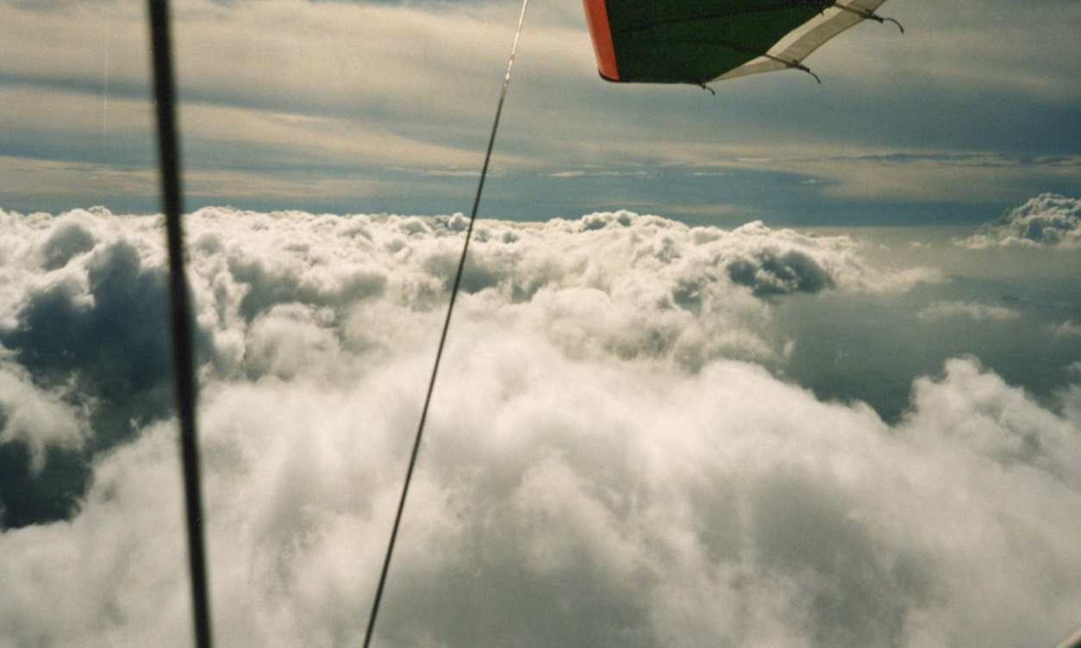
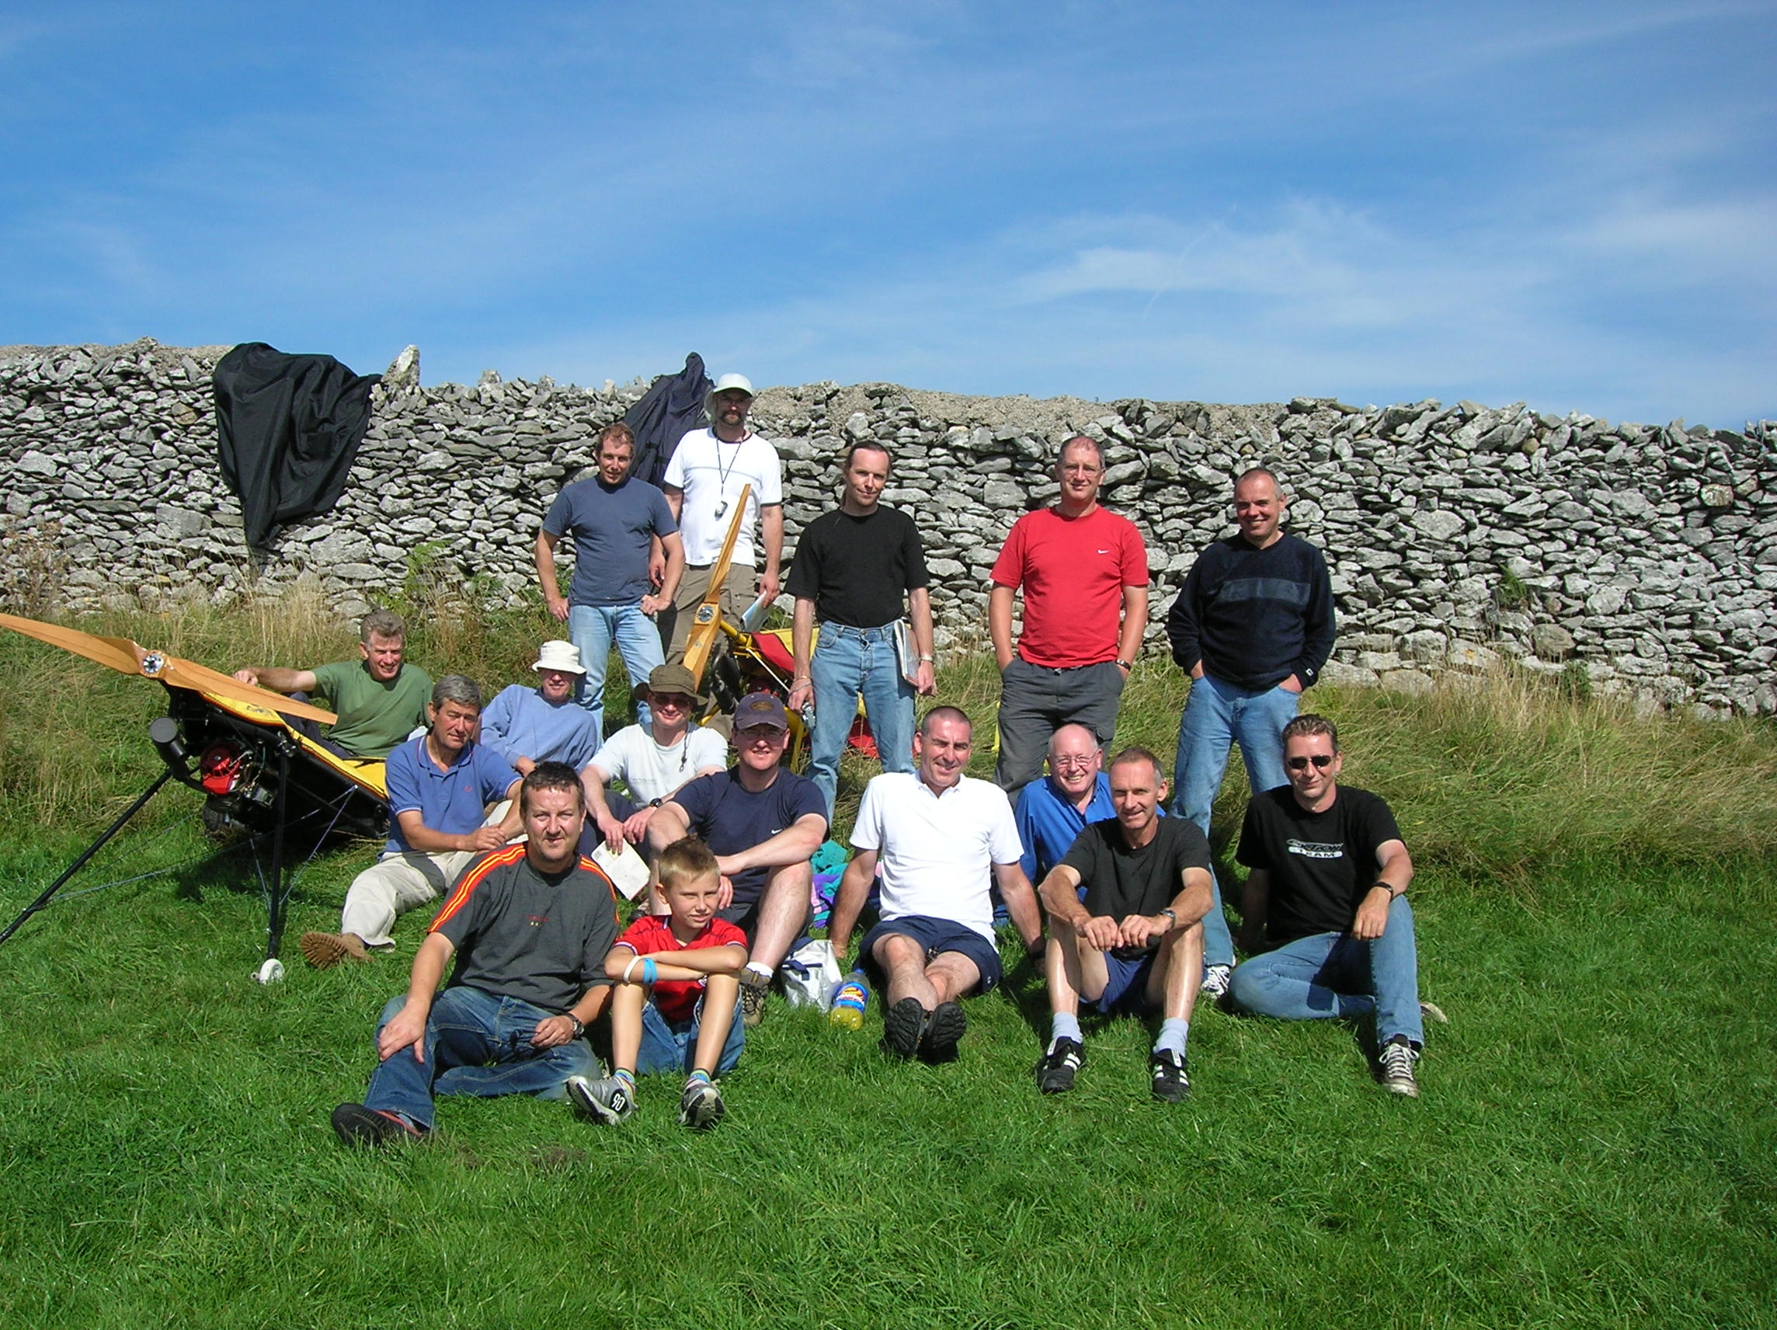
Introduction – background ‘97 – ’05 (power hg)

Slide 6
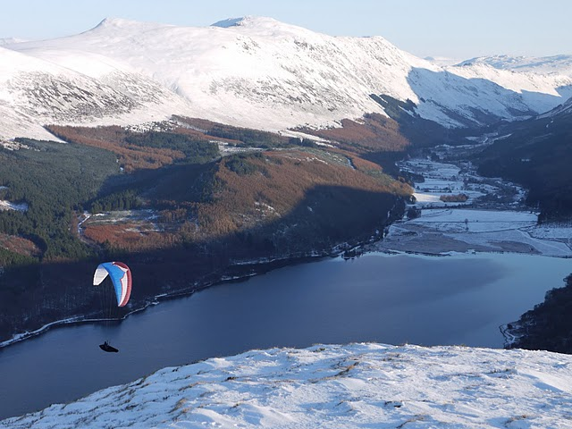
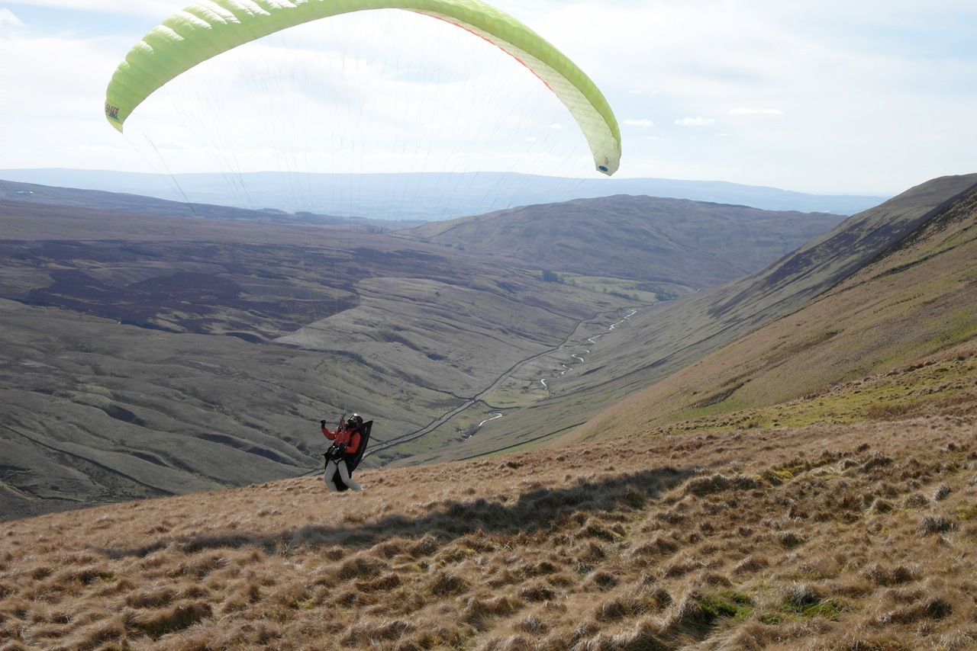
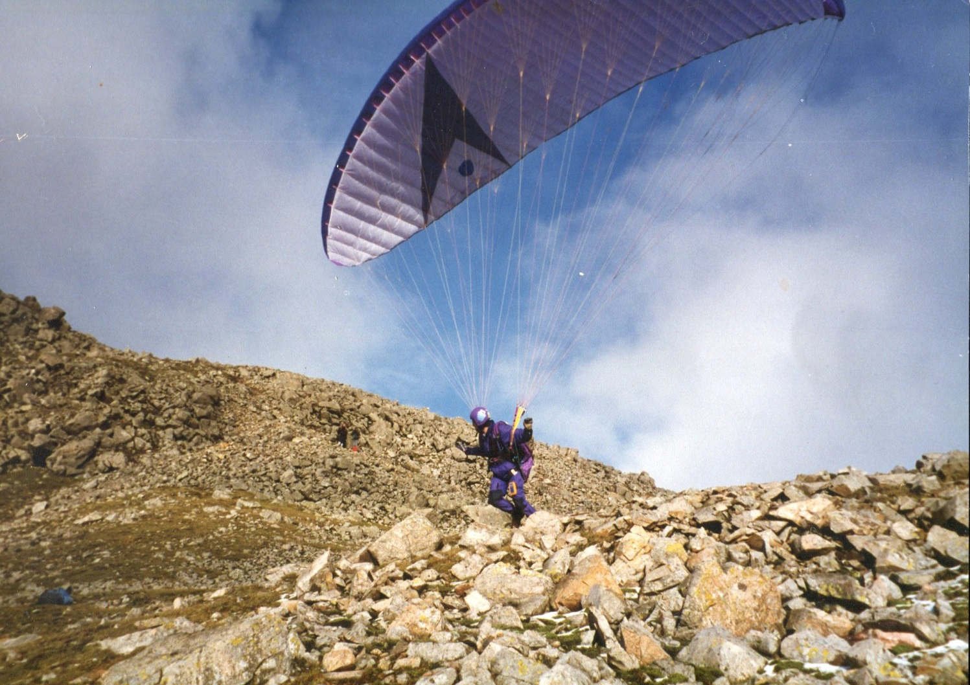
Introduction – background ‘92 – ’06/’13 (paragliding)

Slide 7
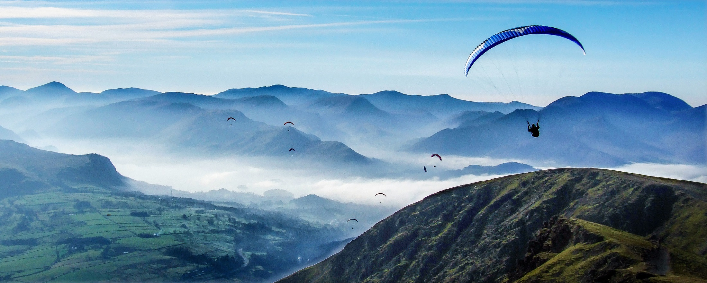
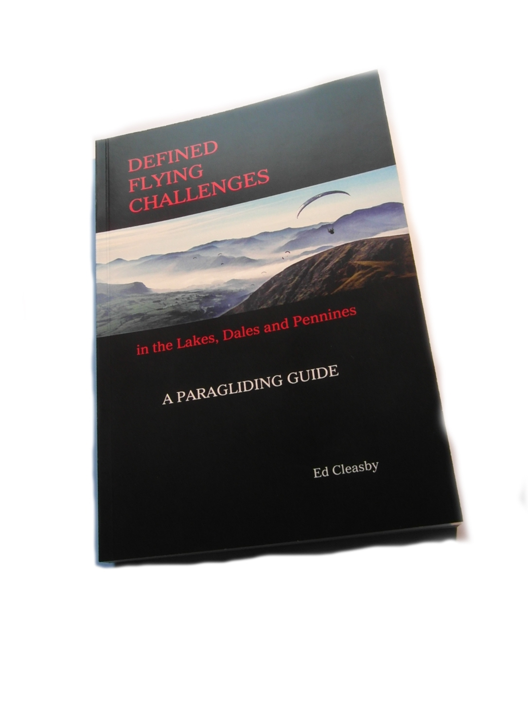
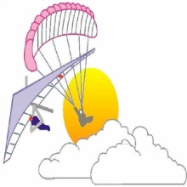
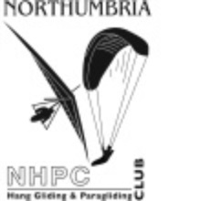
Defined Flying Challenges
In the Lakes, Dales and Pennines
The concept/beginnings
Graded challenges
GPS practice
Individual route planning
Area introductions
Expert commentary
Top six?
www.xcflight.com

Slide 8
DFC - Illustrative pages/sections
www.xcflight.com

Slide 9
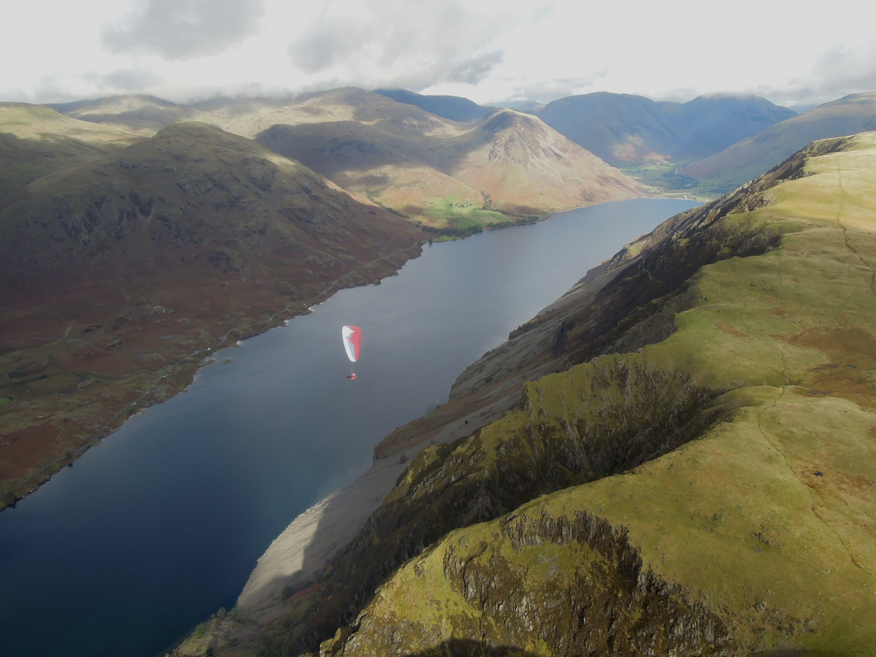
An personal insight into flying the Lake District
Topography
Flying conditions
Some typical routes

Slide 10
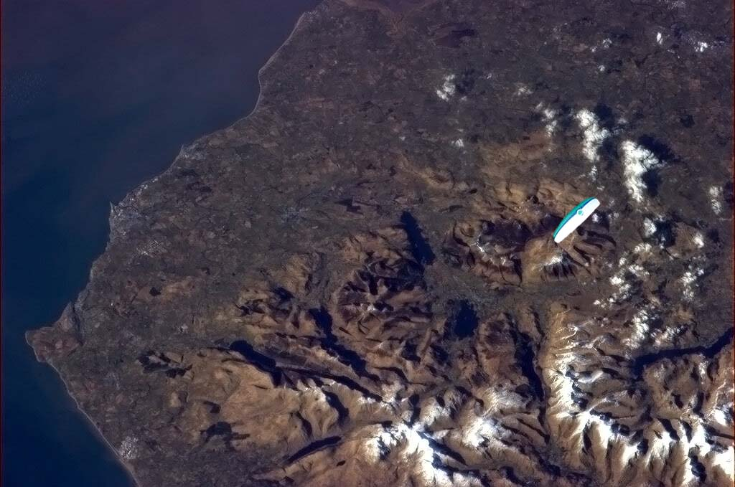
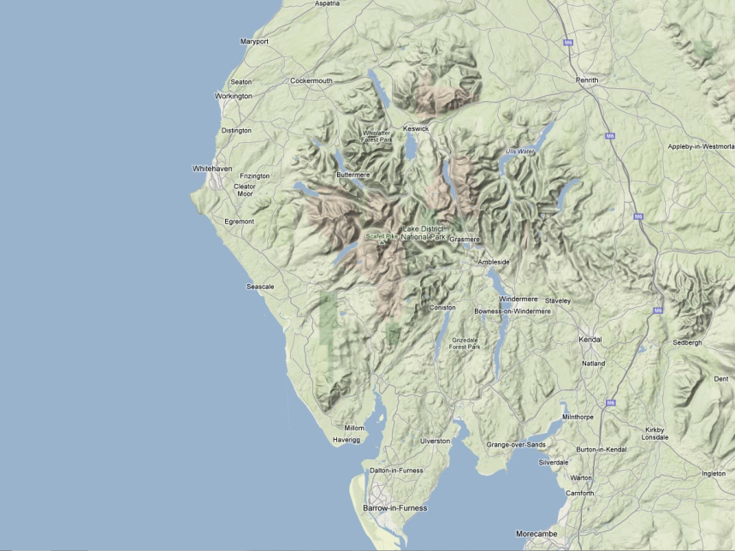
Most of Cumbria from 248 miles – 4/3/2013 (Cumbrian pilots makes extravagant claims)
(
The Lake District
(Topography)
Size/shape
Height – never reaches 1000m
Complexity
Terrain
Near to sea on three sides

Slide 11
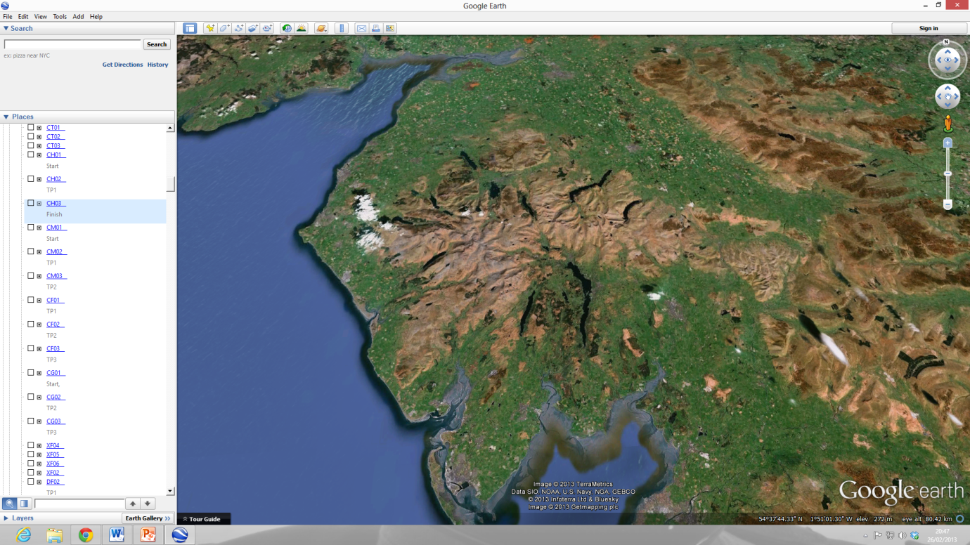
The Lake District
(Meteorology)

Slide 12
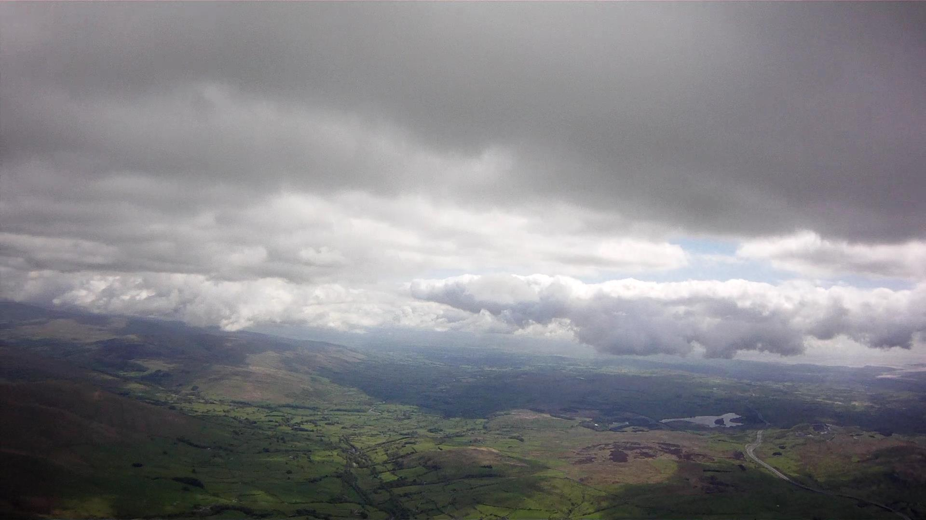
Lift Lines
Sea breeze influence
Airmass
Terrain/topography
Fixed/moving
Factors at work
South Lakes/Dales SB convergence

Slide 13
Areas to avoid
Over simplistic
reasoning

Slide 14
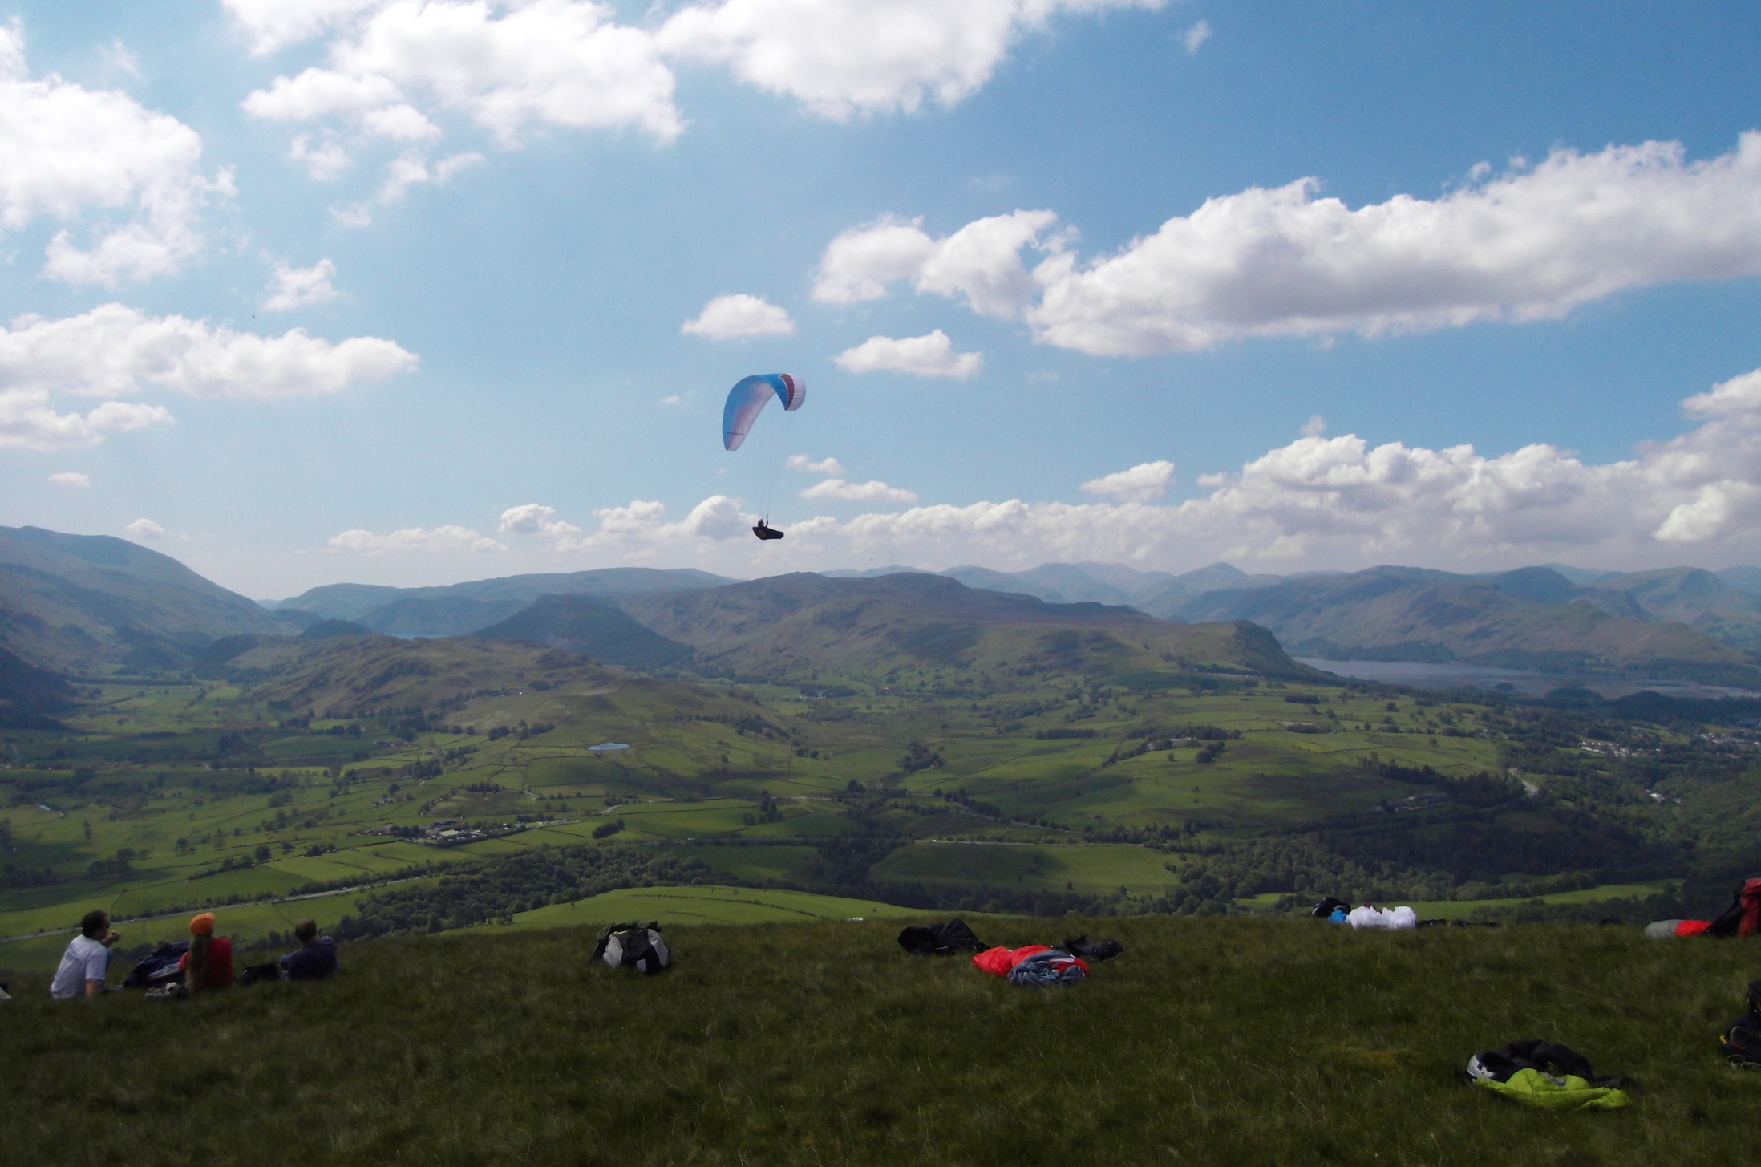
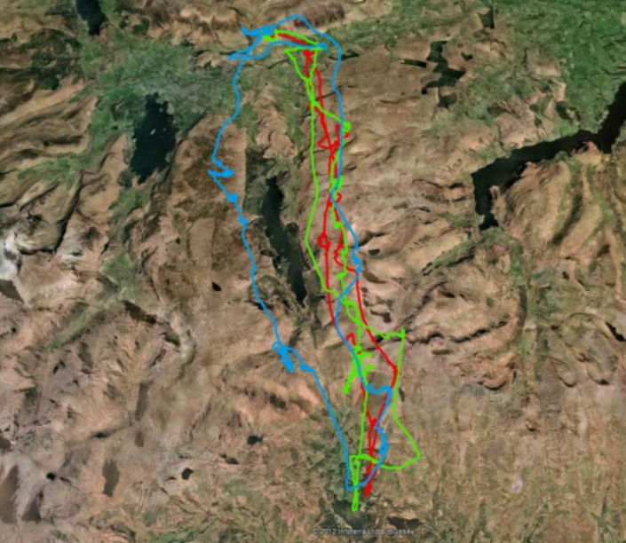
The Lake District (Flying)
Link the ridge lines
Link the convergence lines
Link the known hotspots
LCC – 2011: Declared O & R record

Slide 15
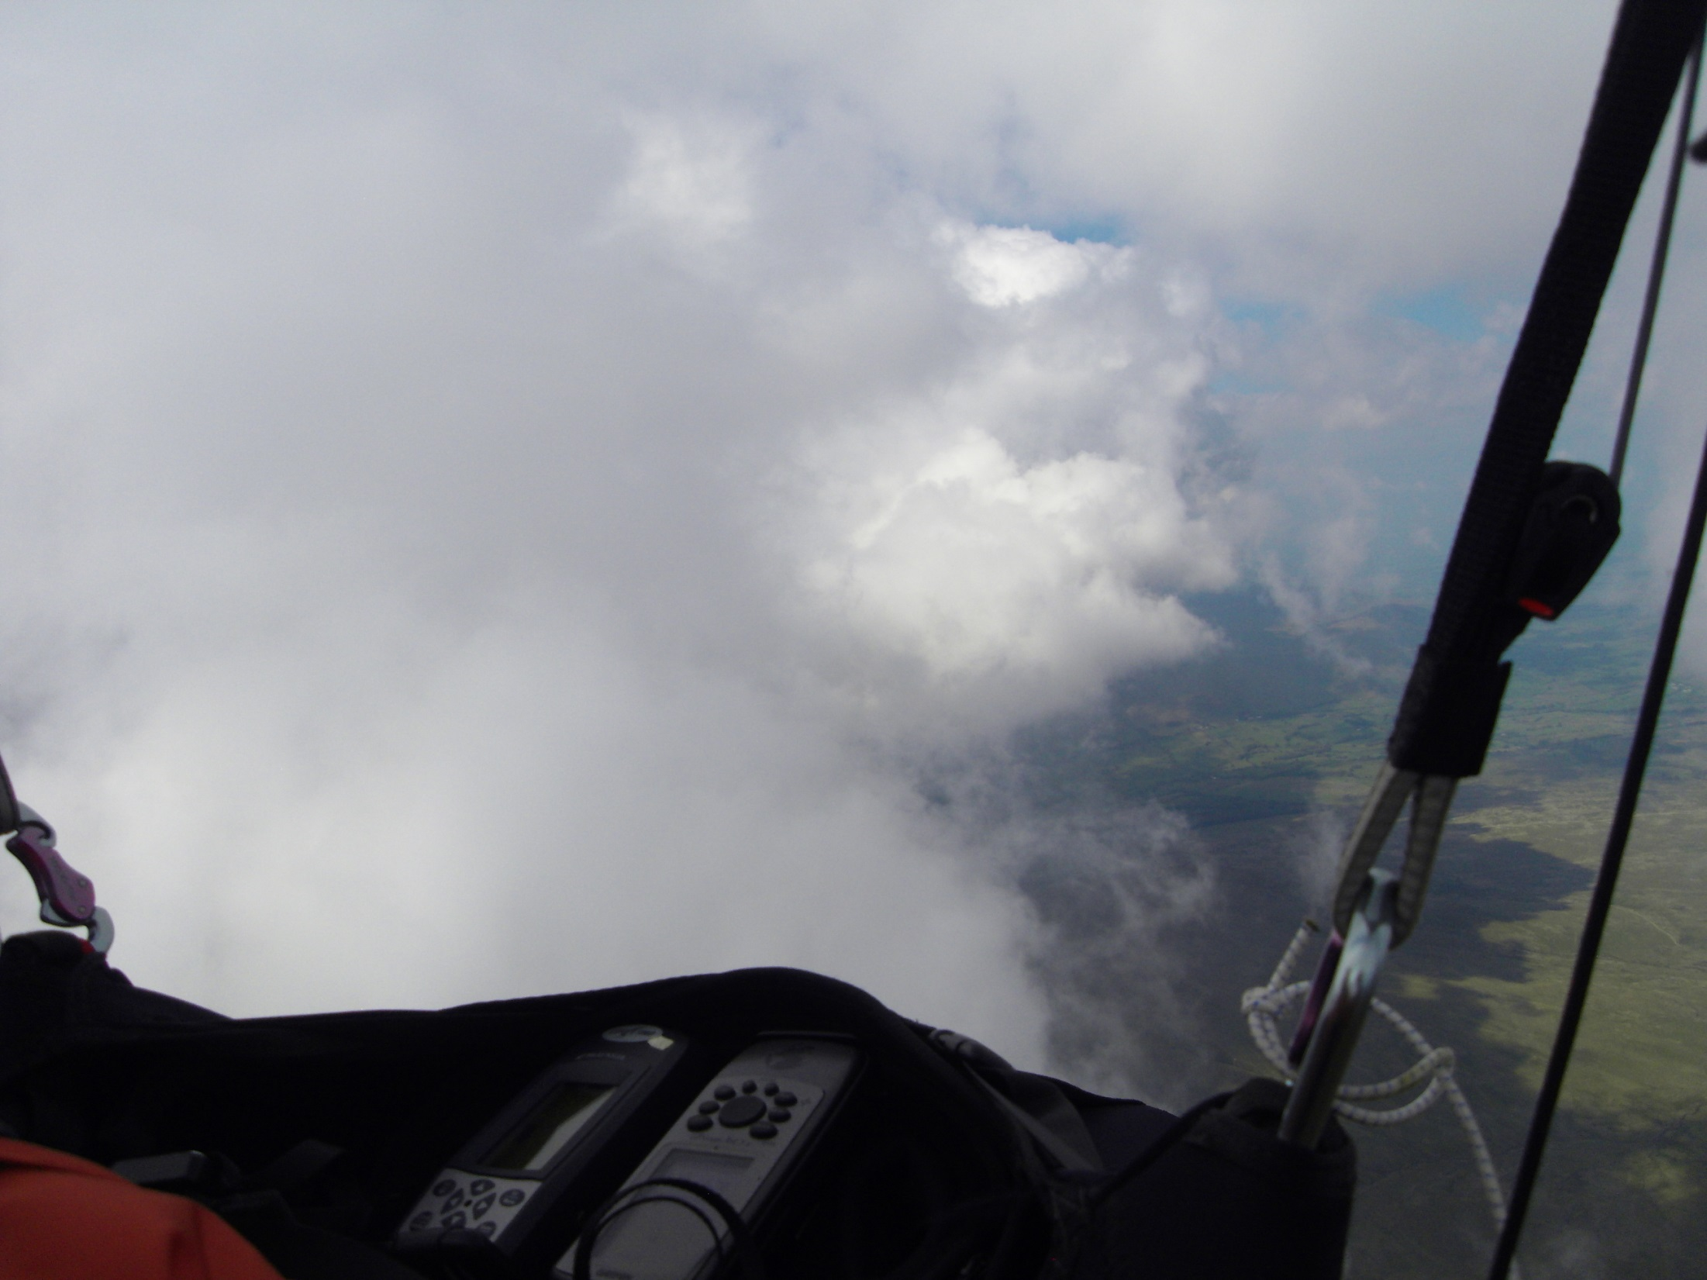
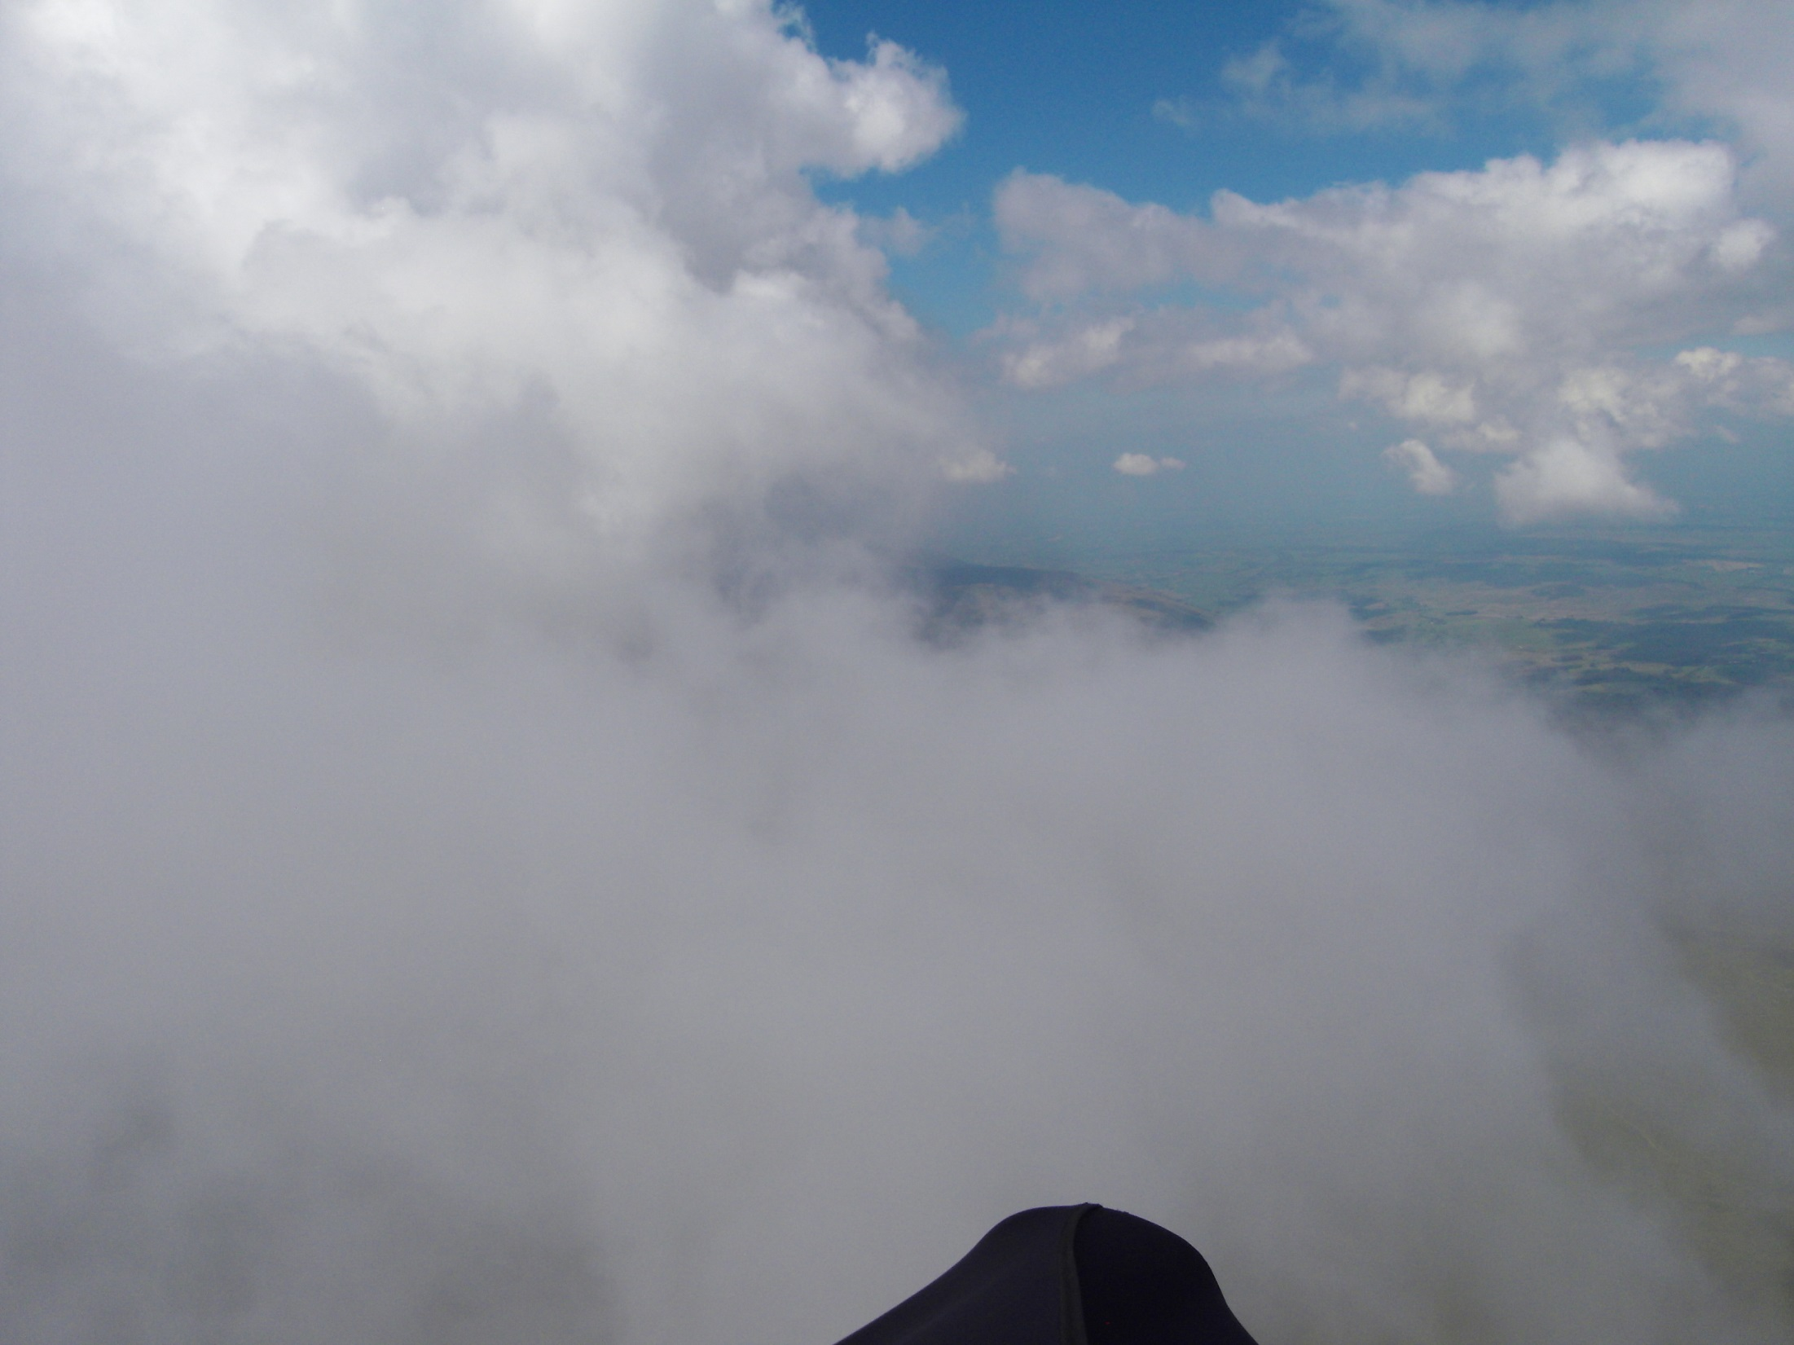
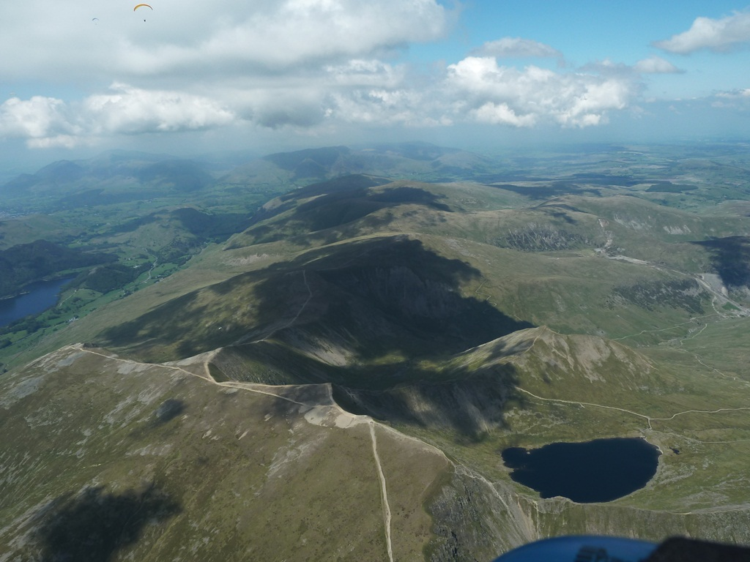
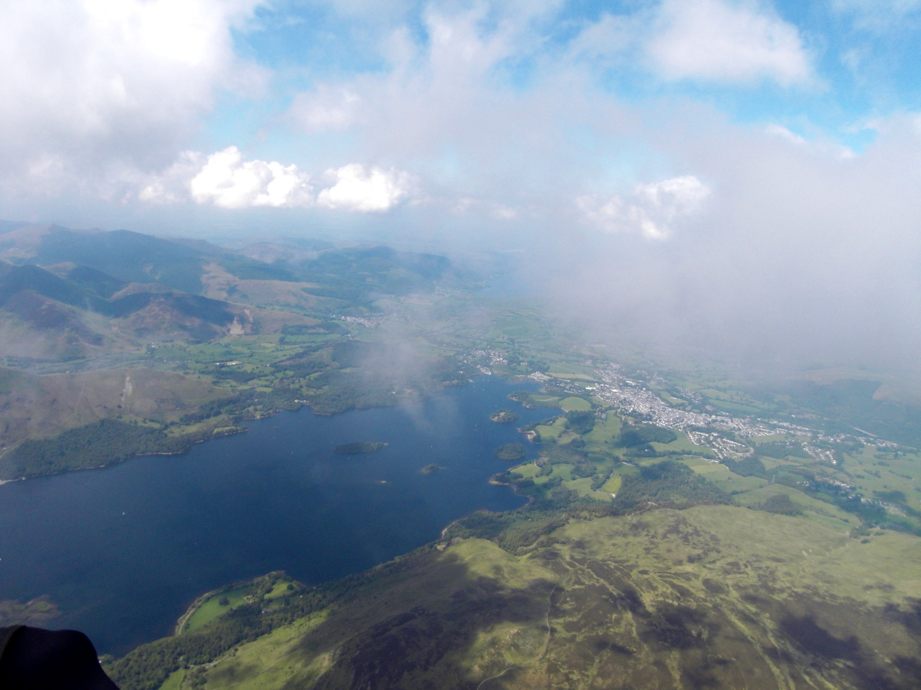
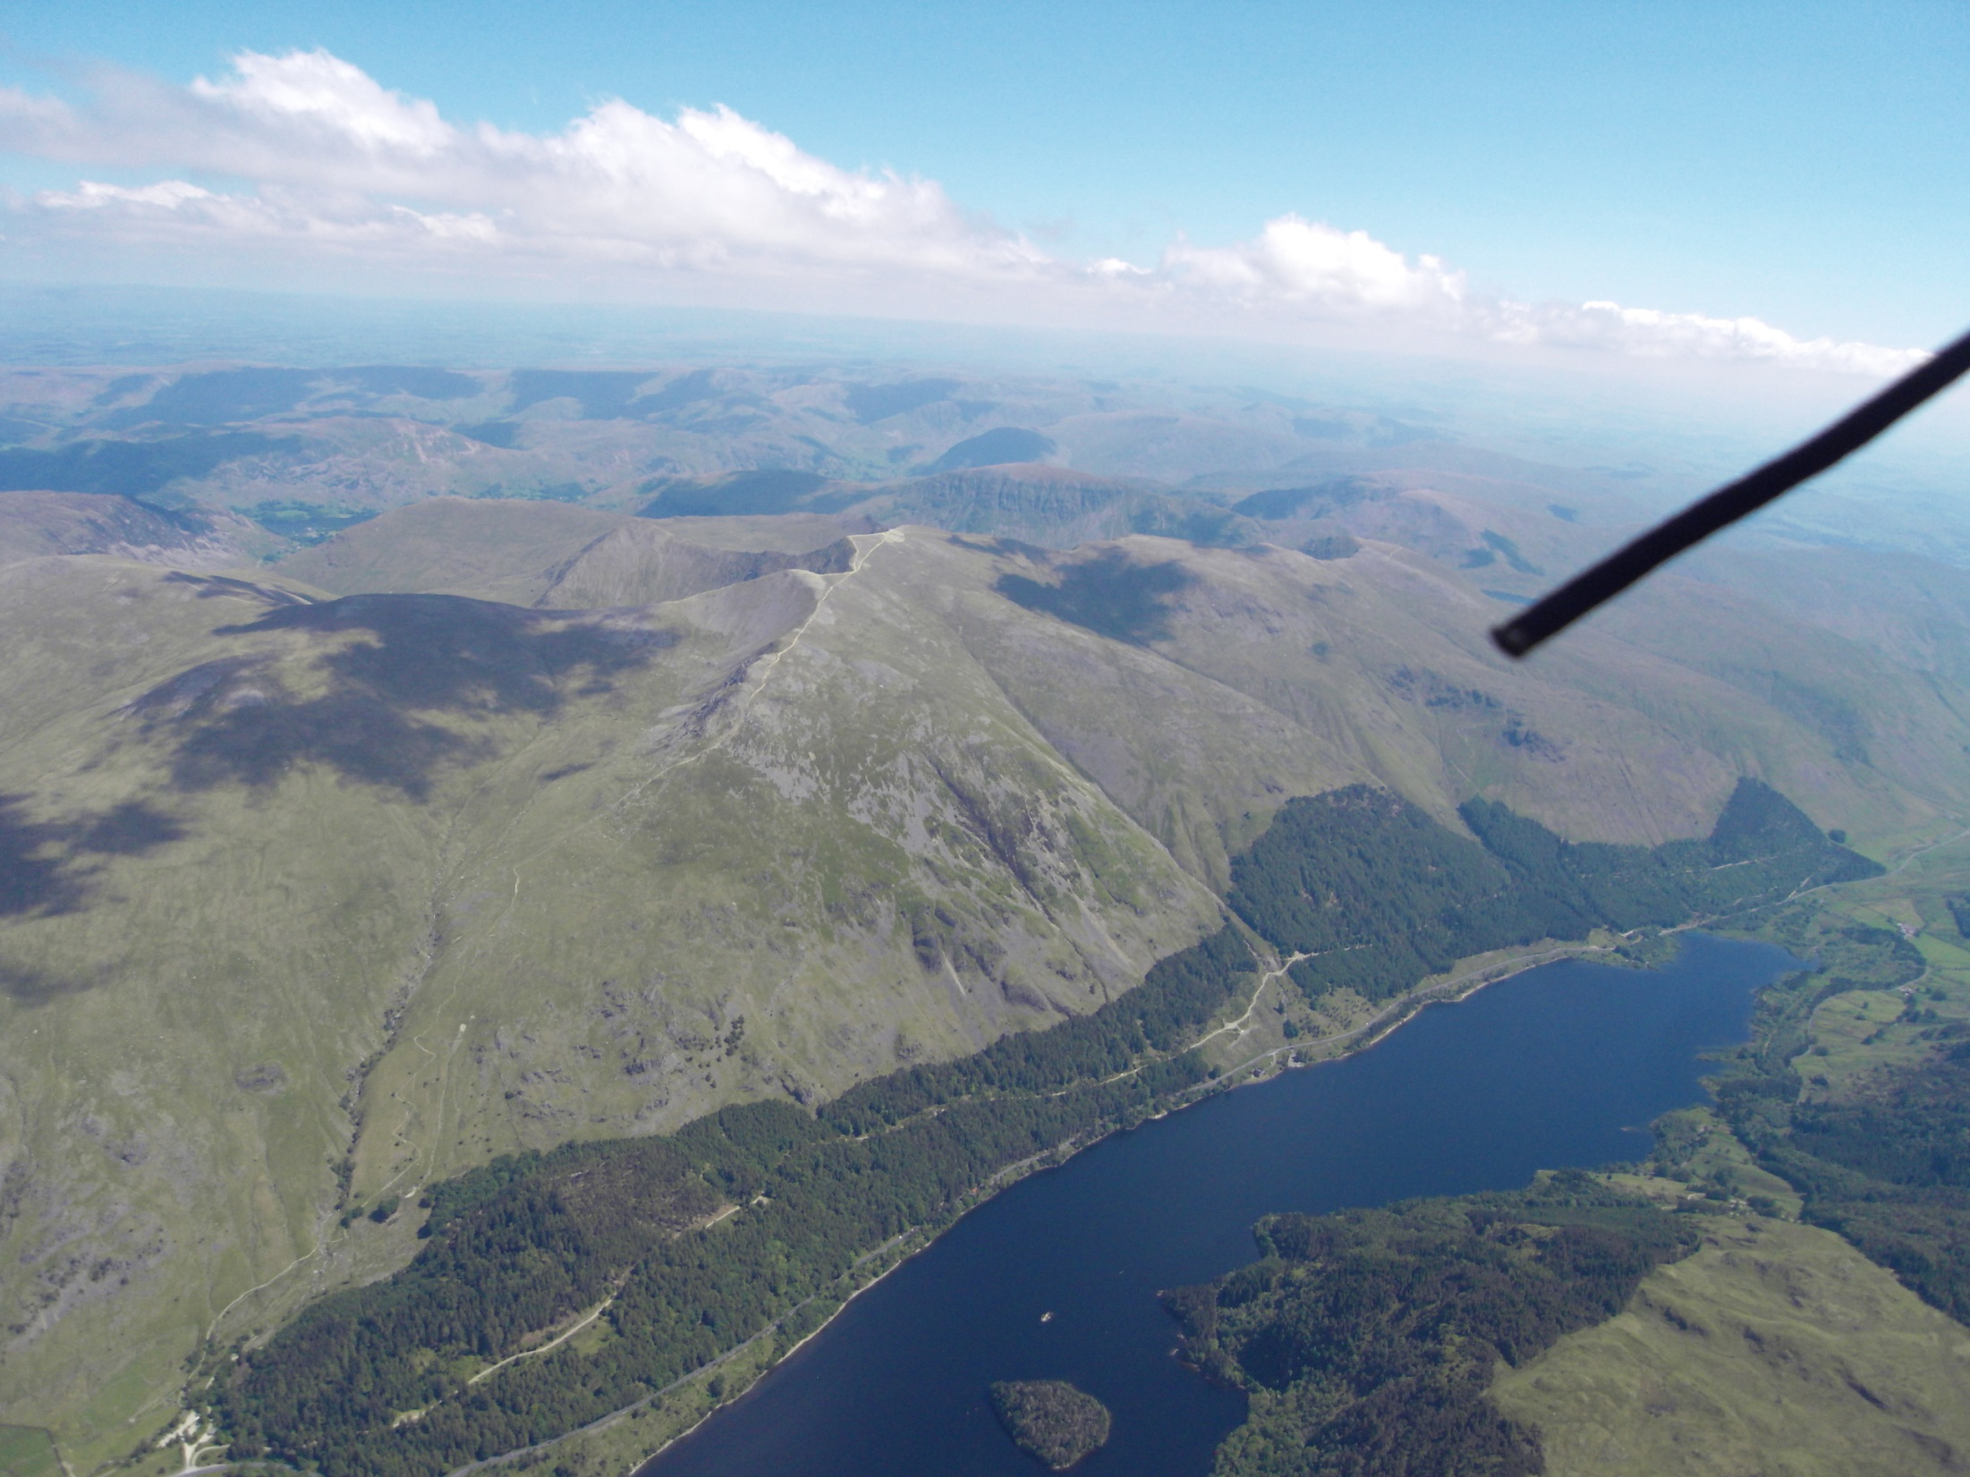
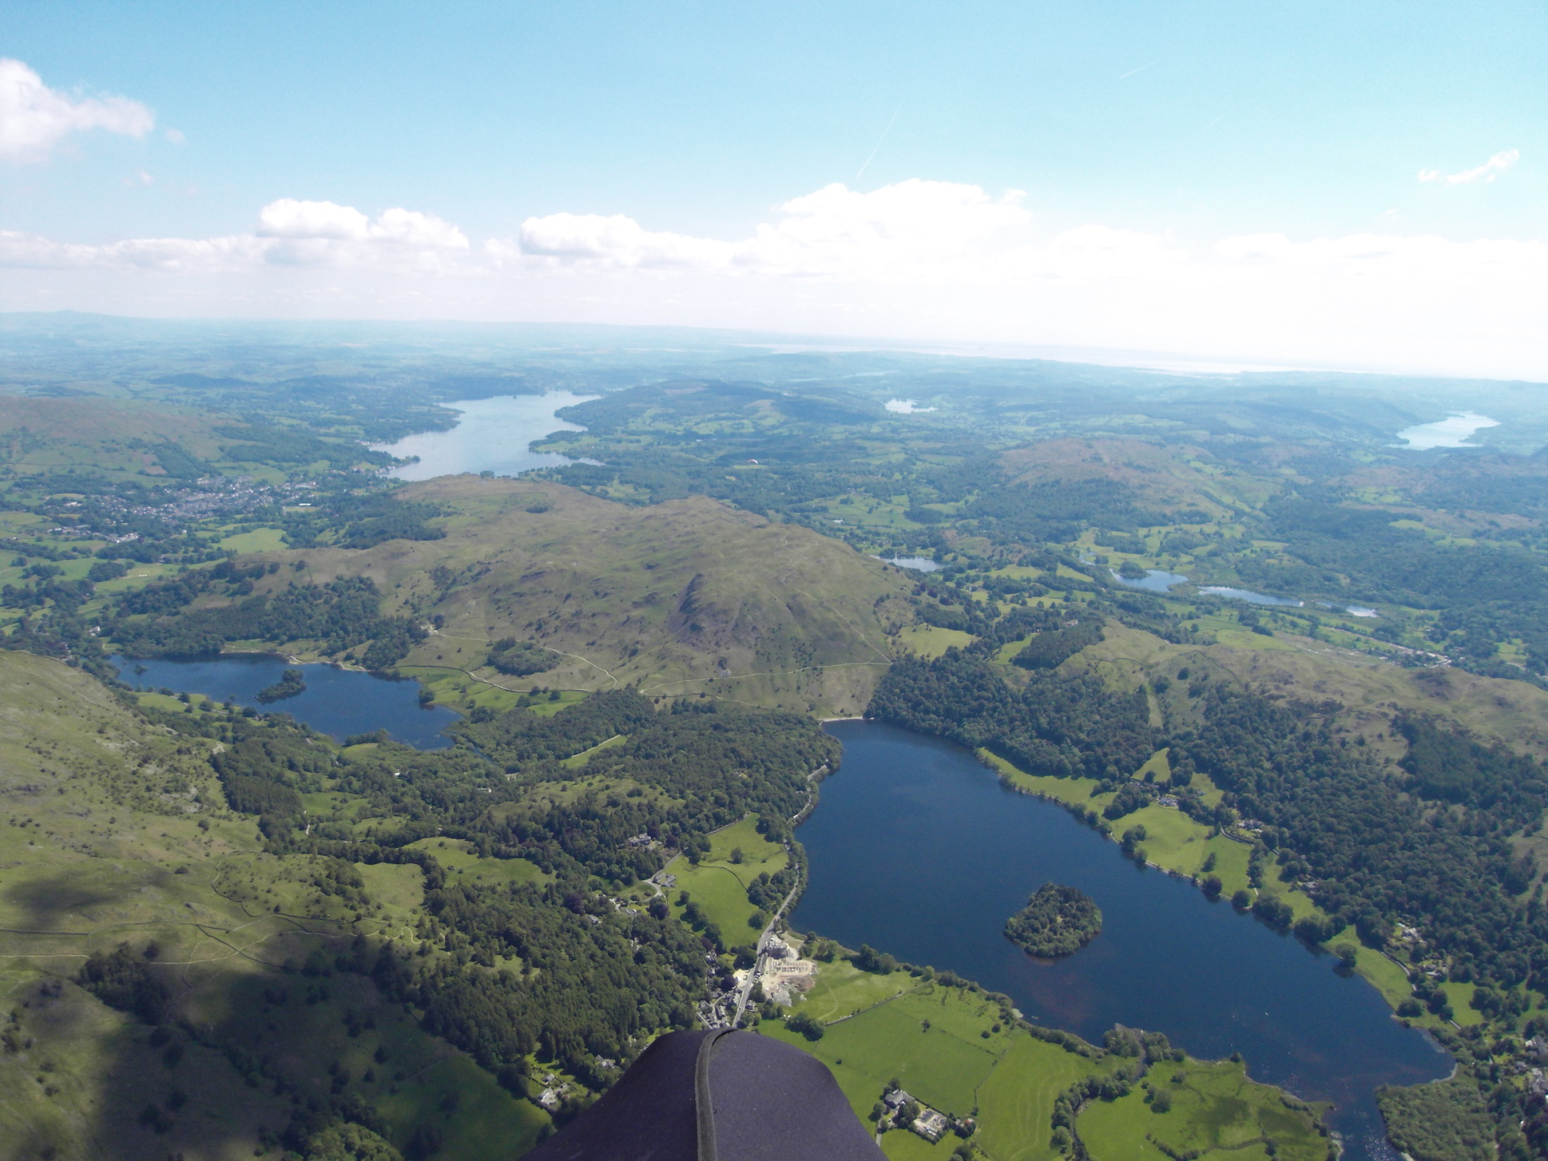
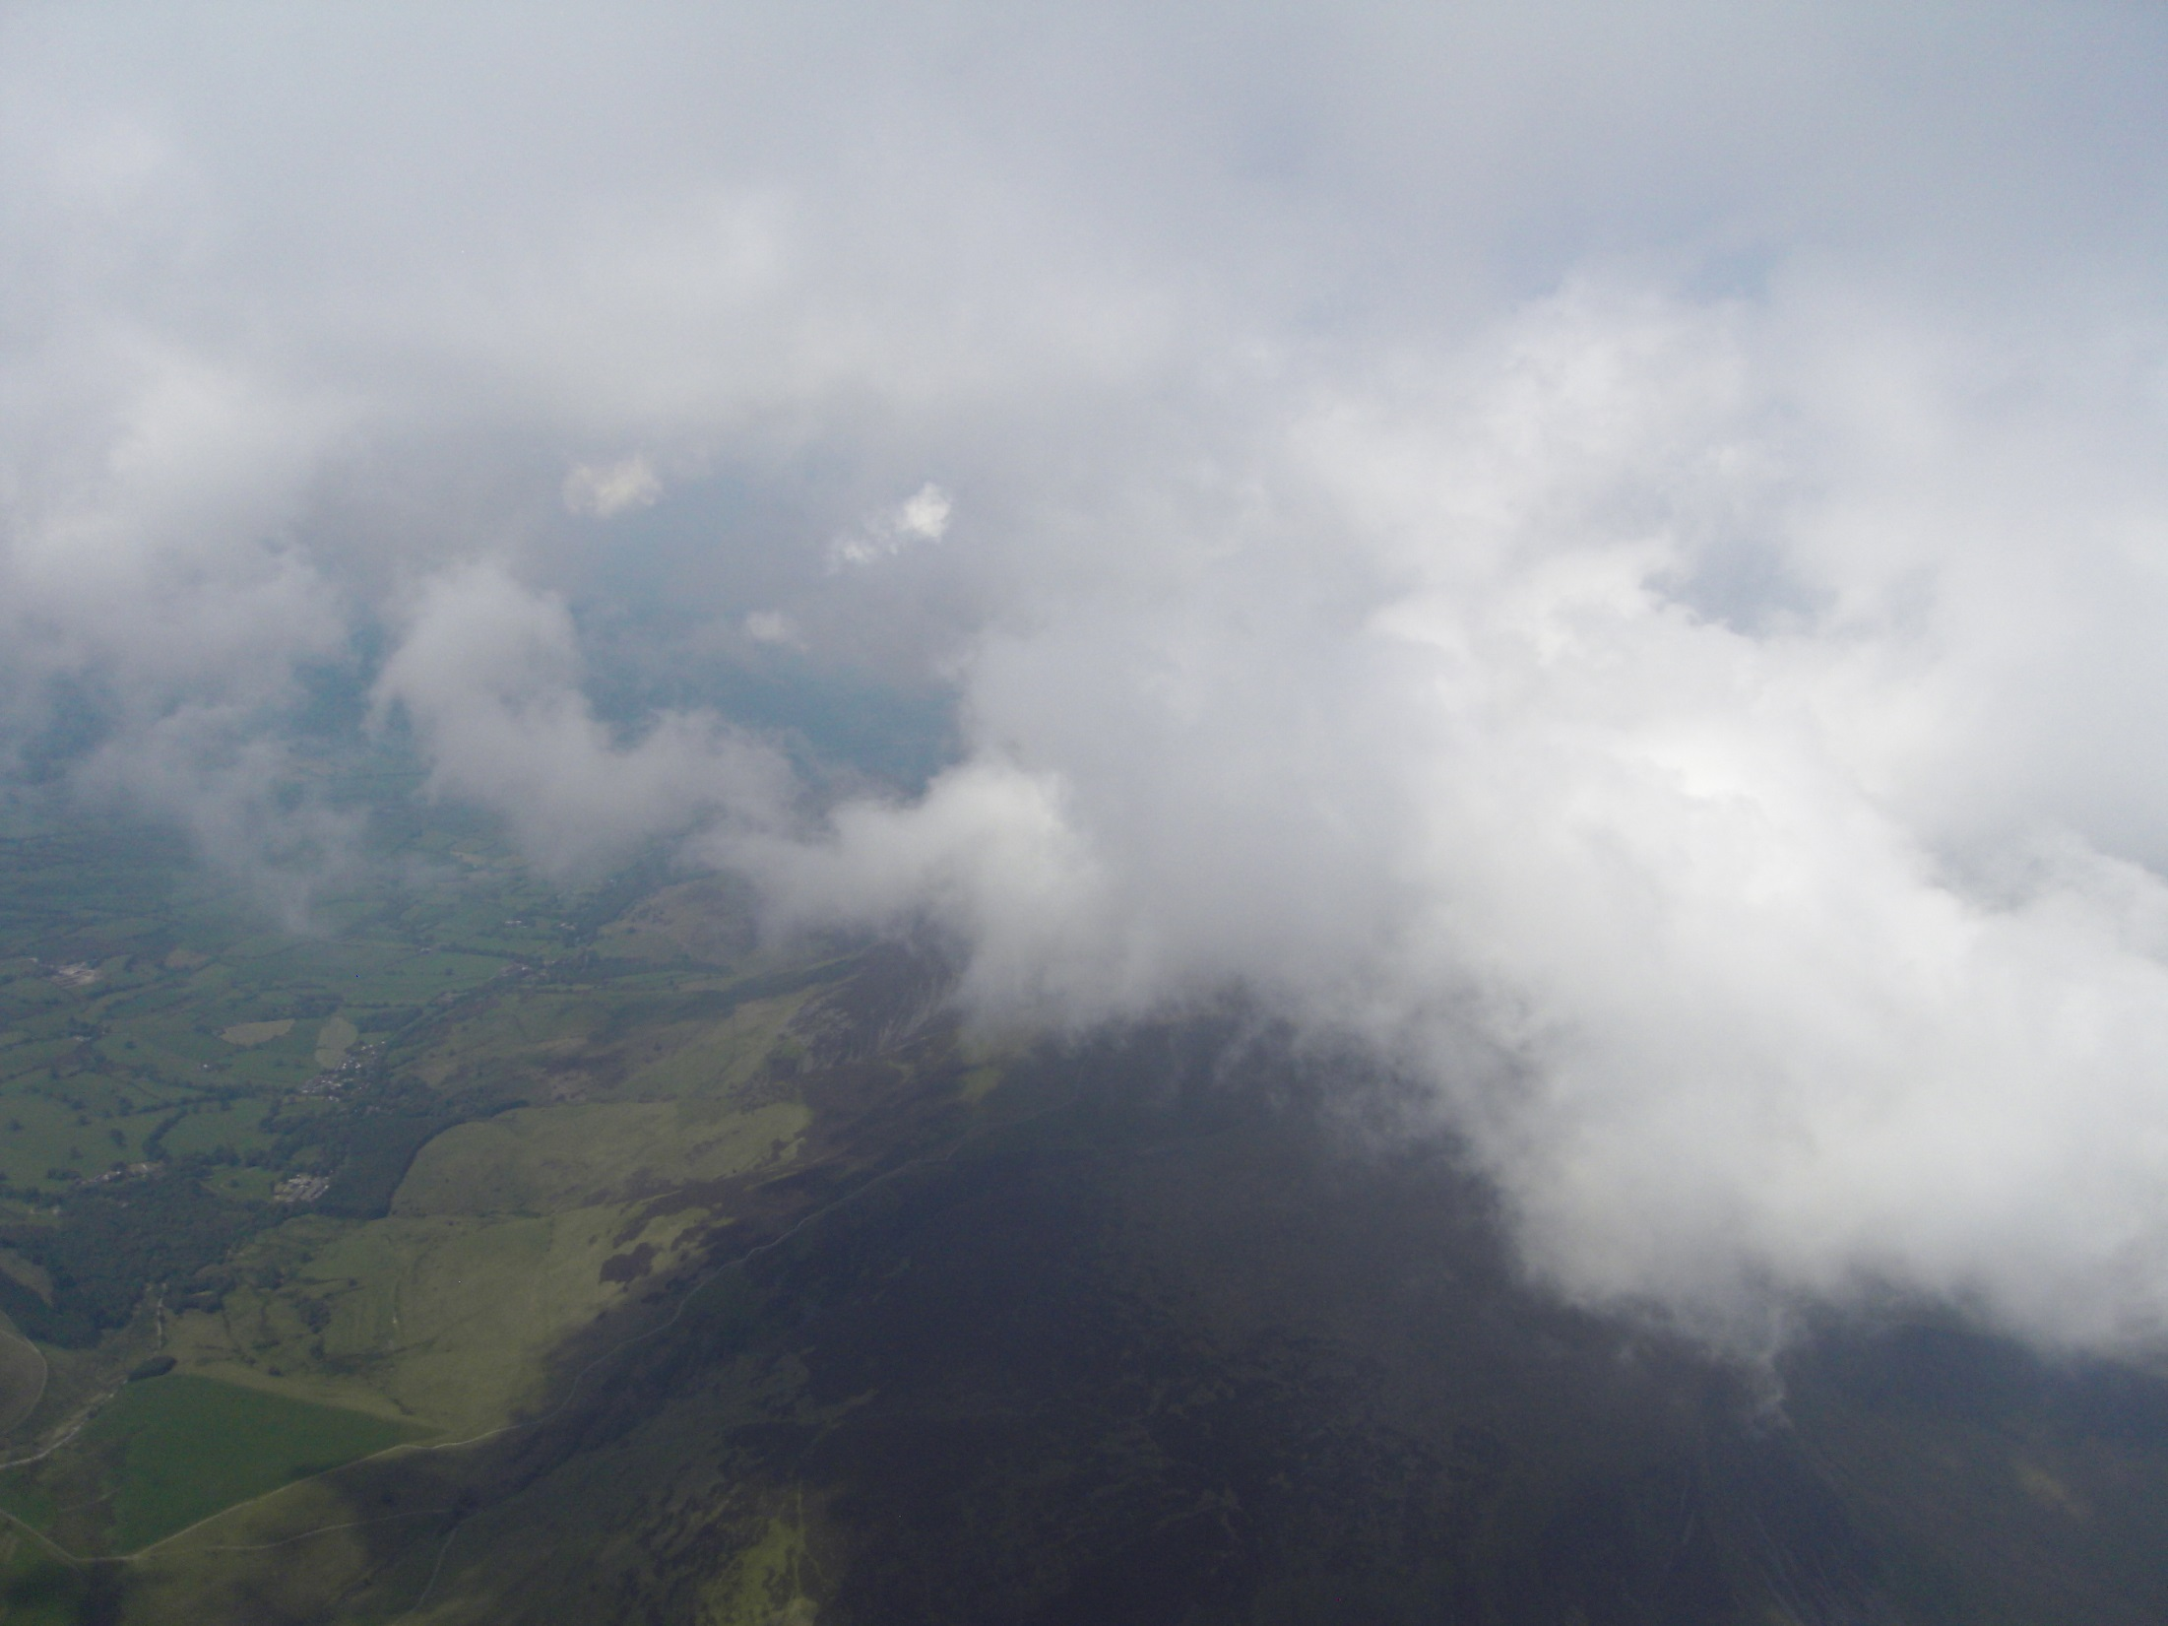
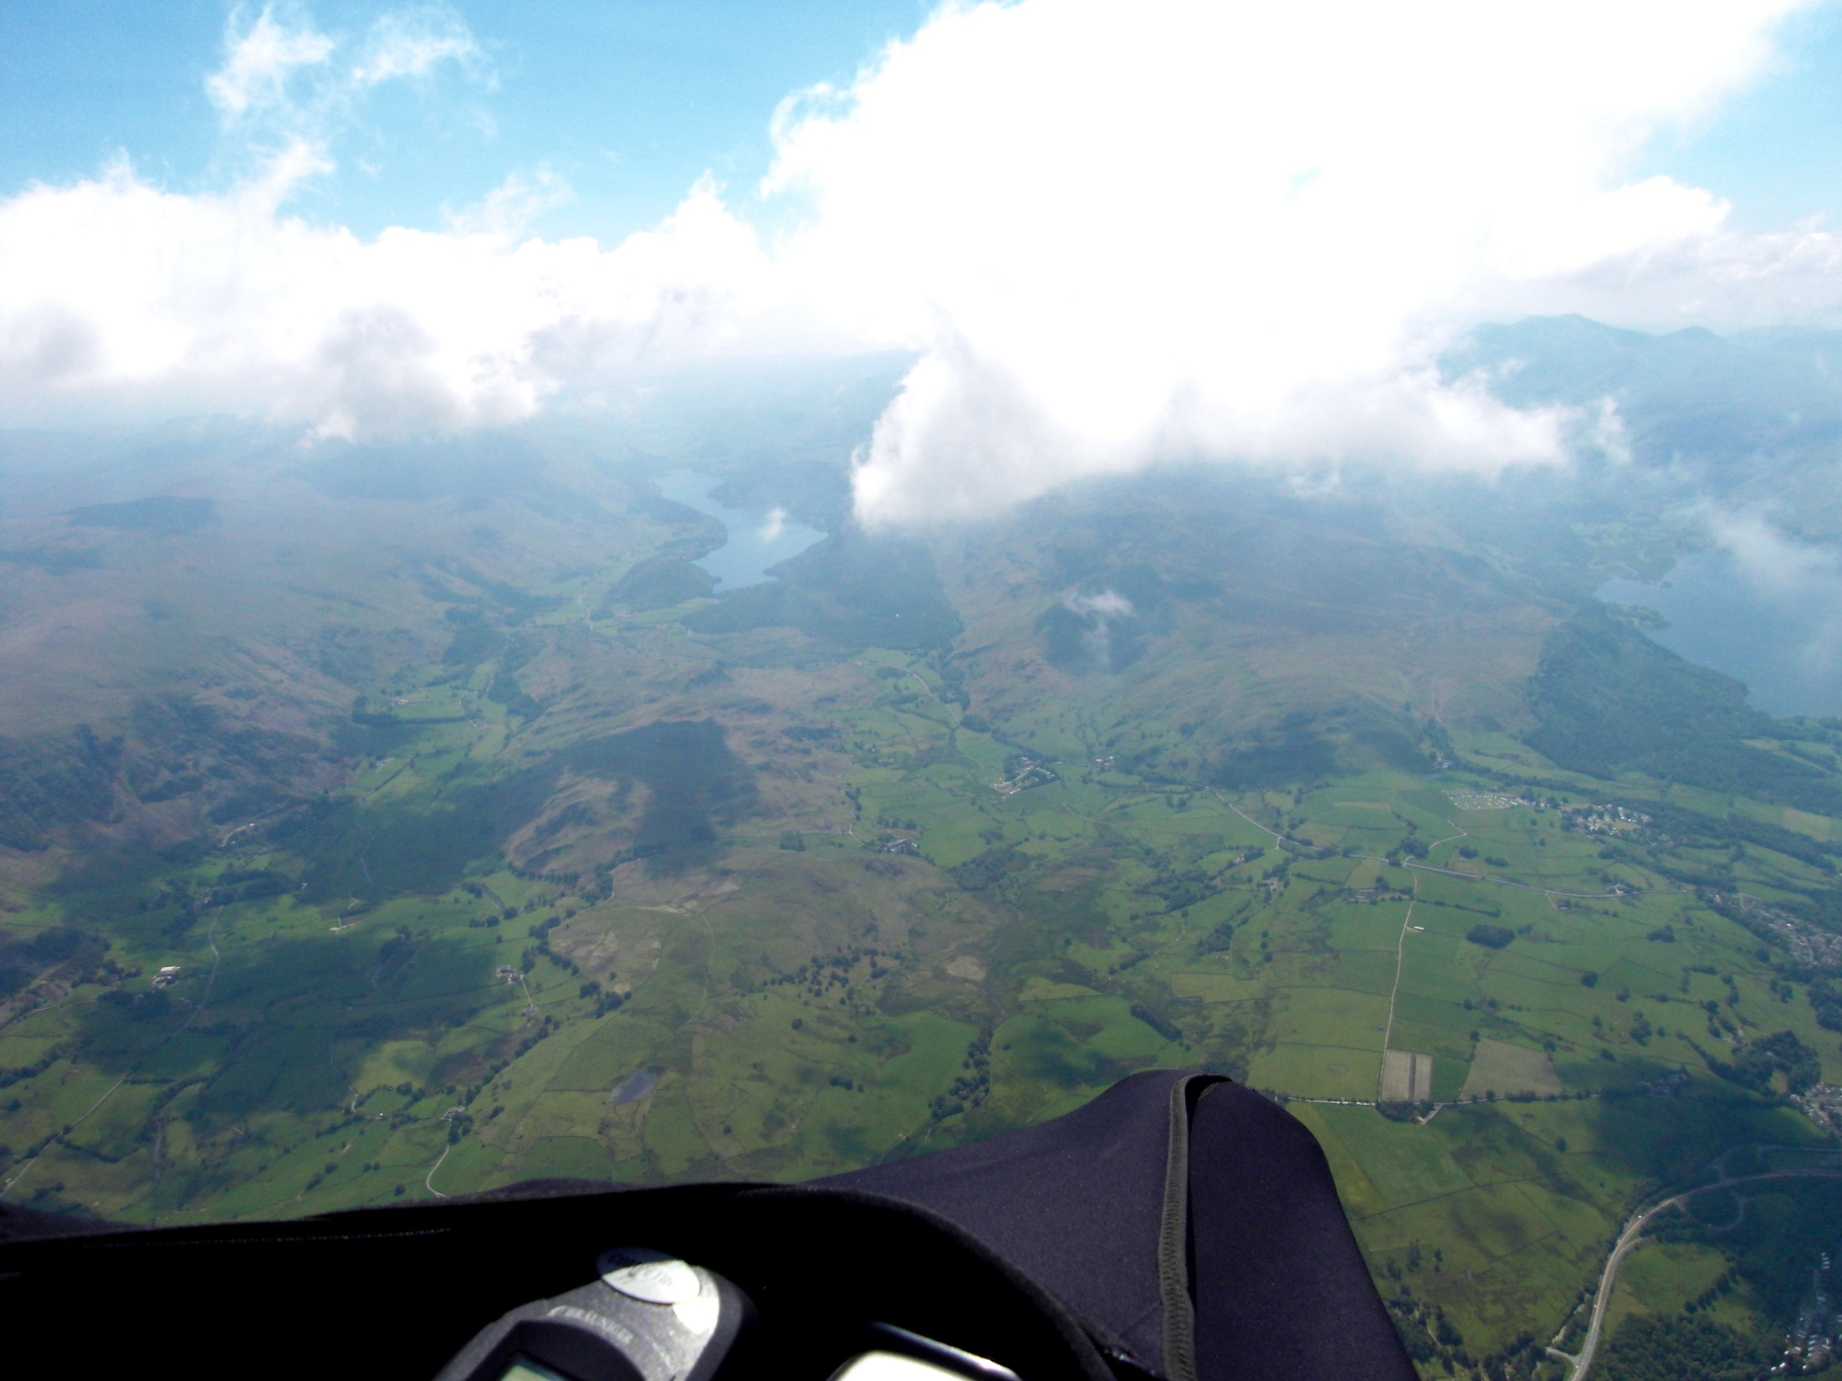
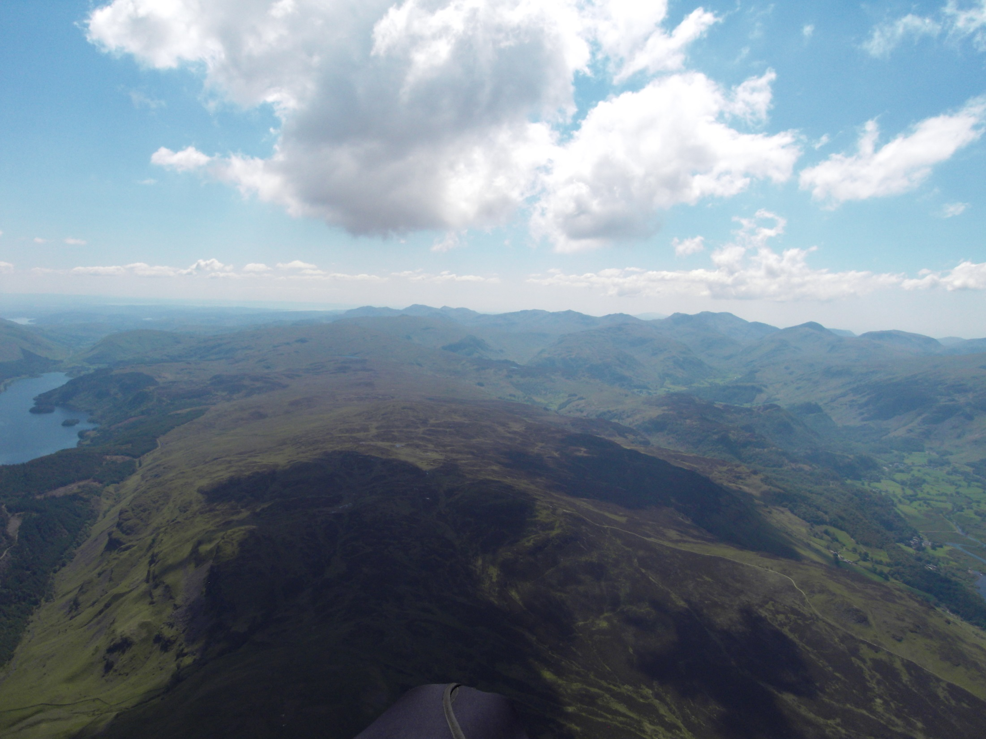
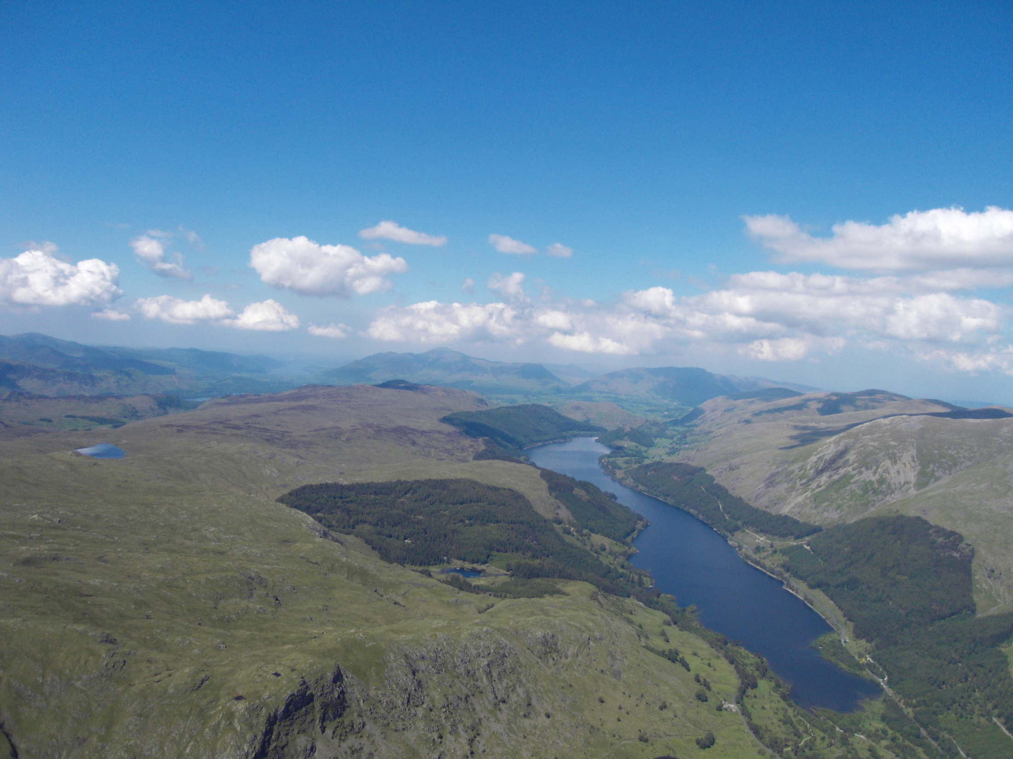
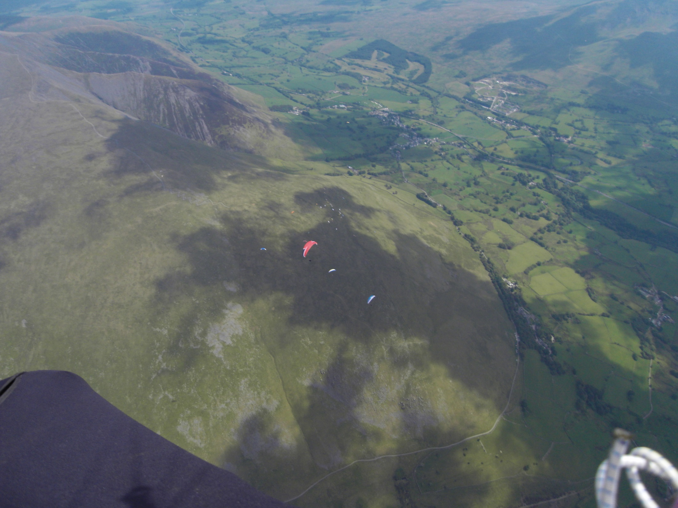
Flying the route – photo set

Slide 16
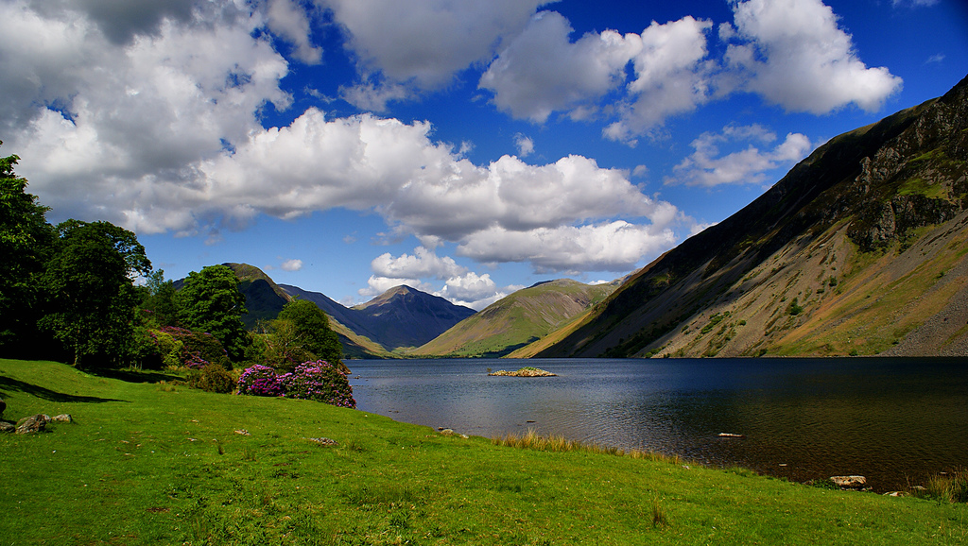
The Lake District – A selection of three mountain routes
Ennerdale/Wasdale/Eskdale
Screes to Keswick
Barton/High Street/Kendal

Slide 17
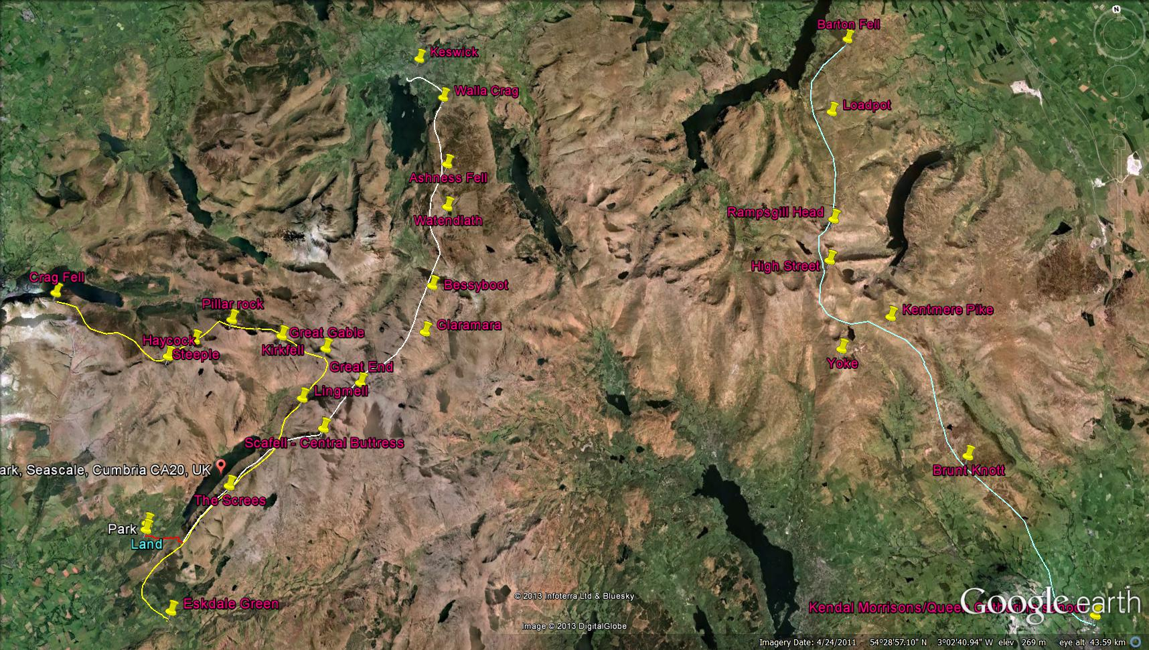
Barton to Kendal
Ennerdale/Wasdale/Eskdale
Screes to Keswick

Slide 18
Ennerdale/Wasdale/Eskdale ------------- route

Slide 19
Screes/Scafell/Keswick ------------- route
Route end (Keswick)

Slide 20
Barton Fell/High Street/Kendal ------------- route

Slide 21
An personal insight into flying the Yorkshire Dales
Topography
Flying conditions
Some typical routes

Slide 22
Yorkshire Dales - general

Slide 23
The Yorkshire Dales
(Topography)
Size/shape
Height – max. 720m approx
Complexity - orientation
Terrain – dark broad moors
Sea influences to east and west

Slide 24
The Yorkshire Dales
(Flying Conditions)
Less affected by sea breeze
Prone to wave – especially in north
through E to SE
Powerful convection lines along high ground
Less explored/developed than Lakes (?)
Good routes out in most directions

Slide 25
Powerful lift
Powerful lift

Slide 26
Lakes/Dales/Pennines
Transition lines

Slide 27
Stags / Moorcock / Caperby - 30k with 2tp
One of the first routes I put together for DFC
Very average day with lowish base and 7/8 cover
Started as O&R until offered lift back – went for Leyburn
Wanted to fly Cotterside – denied permission
Others asked for route details – then other routes
Good to try things – however small.

Slide 28
Site Developments in the Dales (Top Secret!)

Slide 29
Undocumented sites between
the CSC and DHPC areas.
Mallerstang
Wild Boar
Cautley
Winder
Great Combe
Deepdale
Whernside (west)
Barbon (Johnny Barnes)
Gragareth
Ingleborough (west bowl)
Ingleborough (Simon/Park Fell)
Pen y ghent (west and east faces)
Wharfe
Helwith Quarry

Slide 30
Questions?
www.xcflight.com

